Slide 1
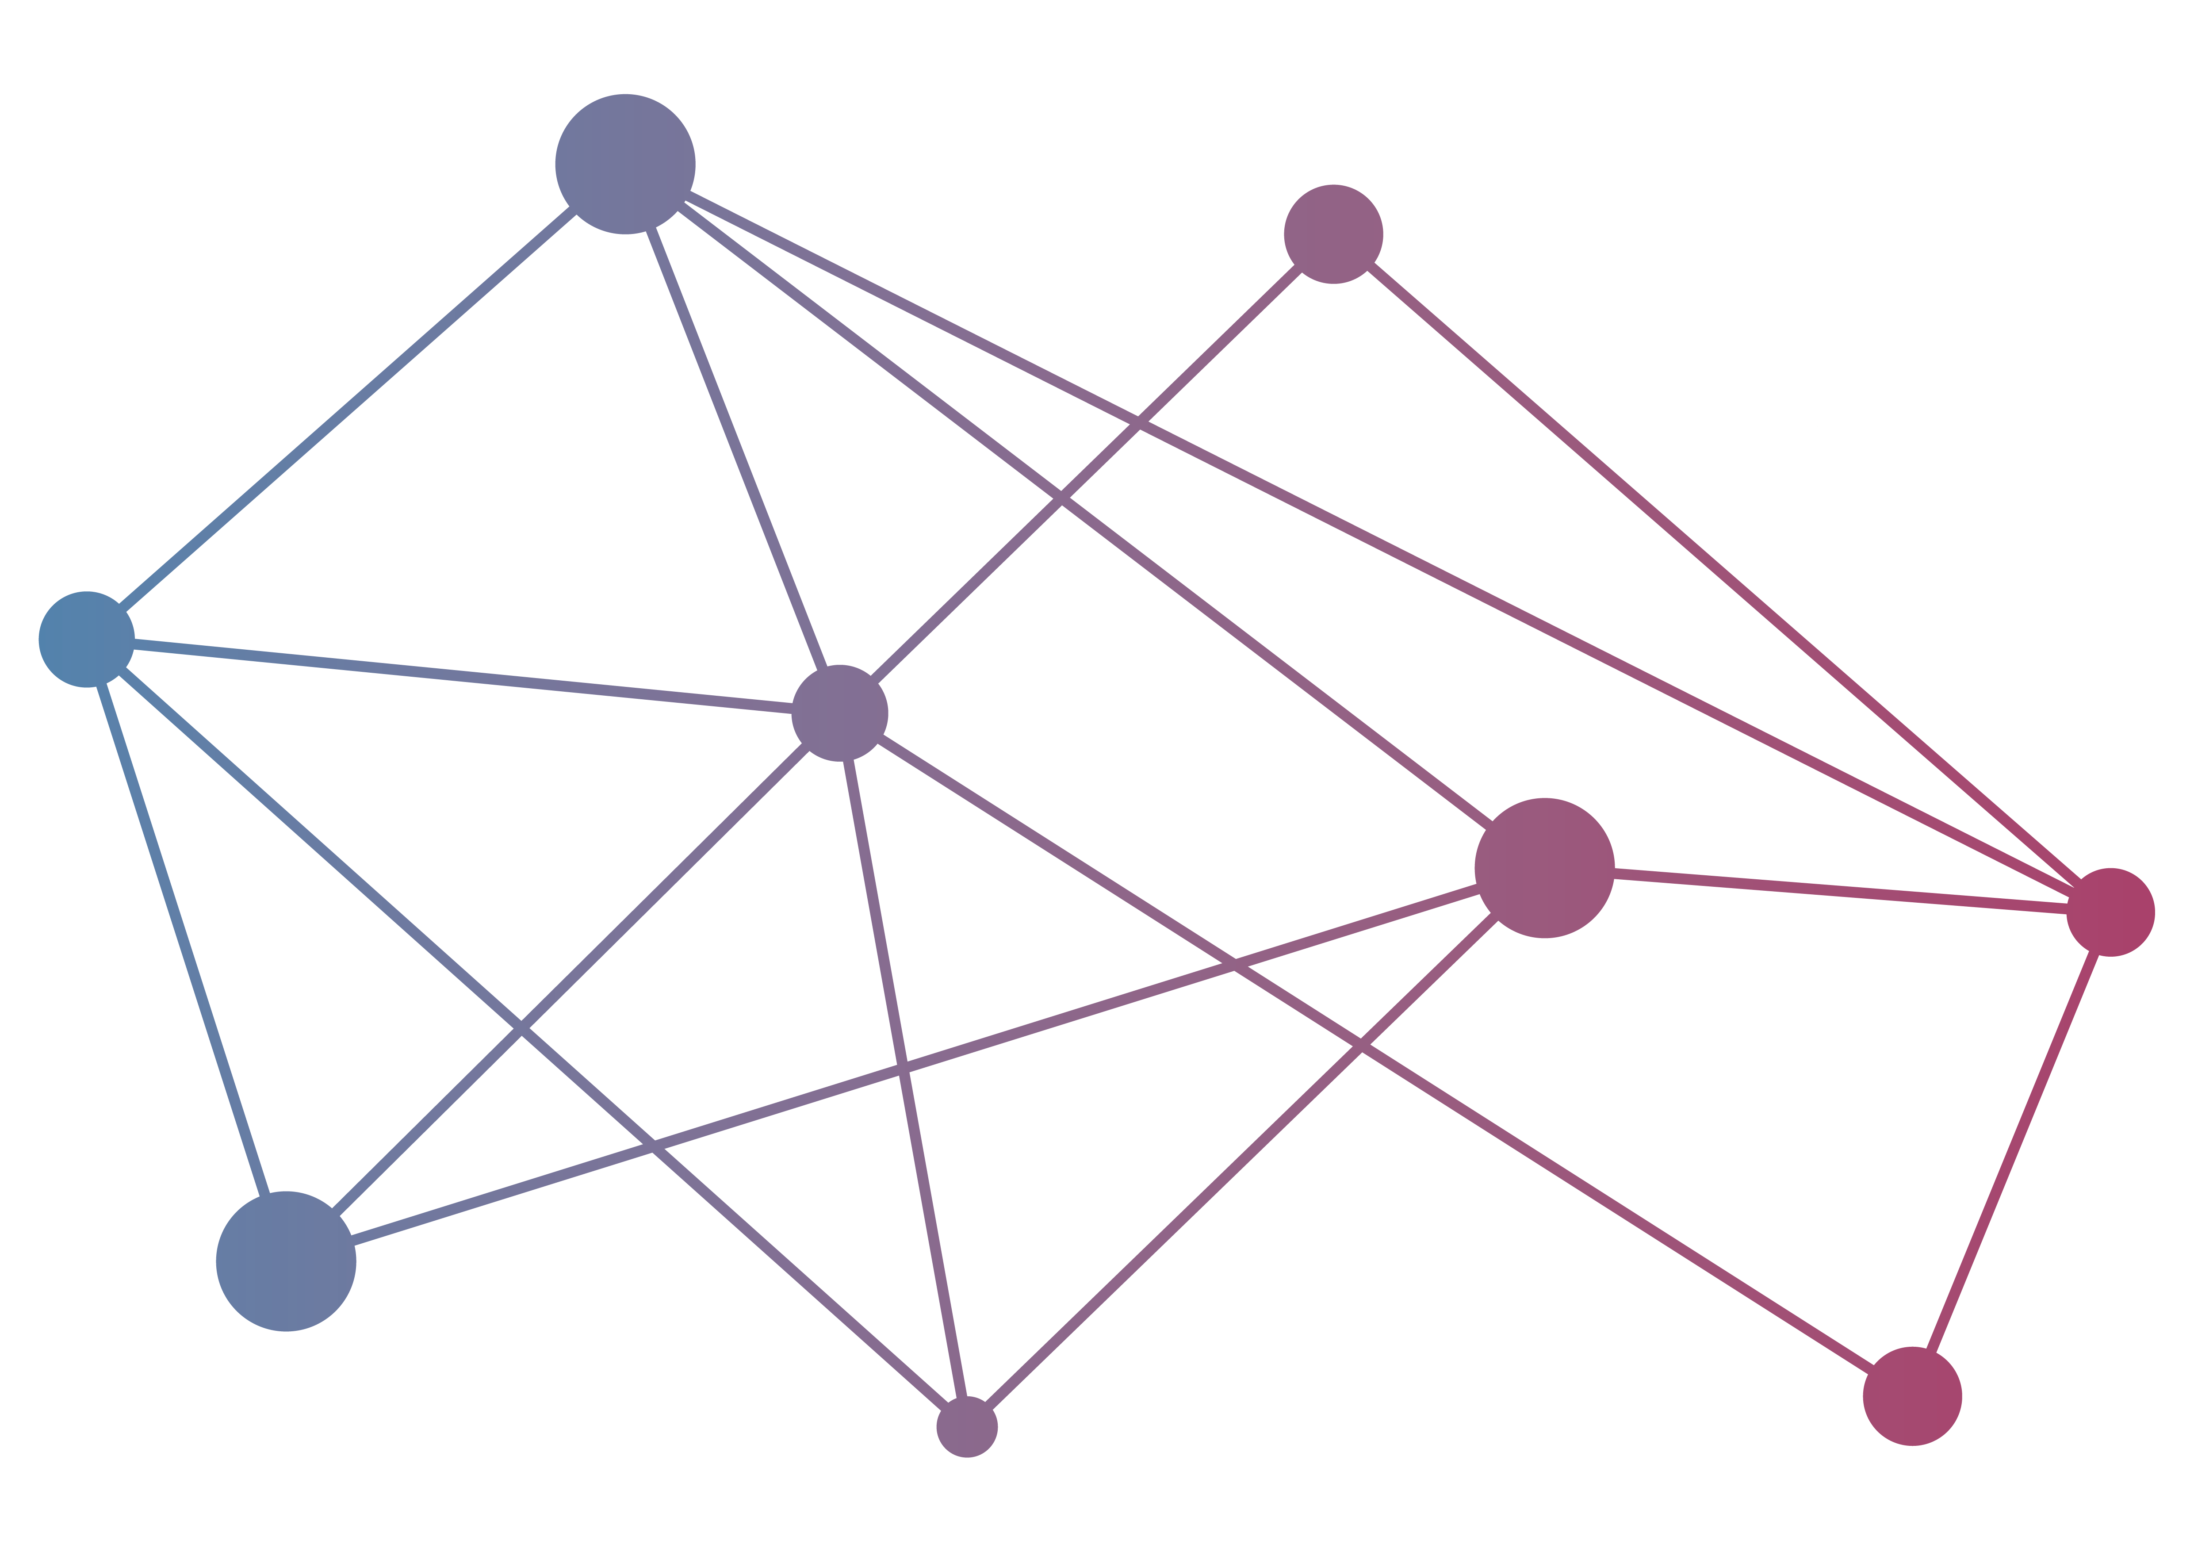

Data and Analytics Facility for National Infrastructure
Tom Kirkham & Kyle Stevenson

Slide 2
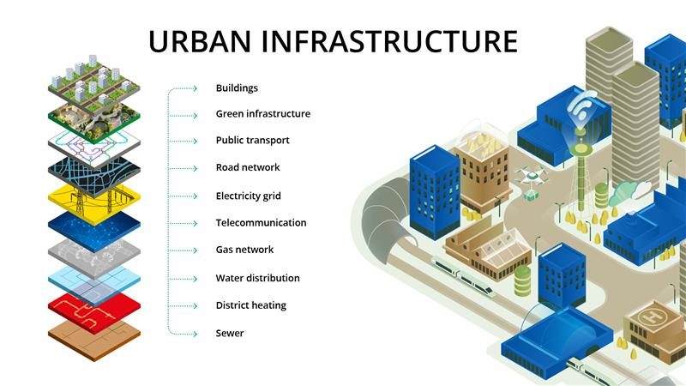
What is DAFNI?
The Data & Analytics Facility for National Infrastructure
£8m investment in 2017-2021 under UK Collaboratorium for Research on Infrastructure and Cities (UKCRIC)
Computer platform for research into decision making for national infrastructure.
Wider programme of work engaging Government, Industry and Academia.
Image: Kolbjørn Skarpnes, NTNU https://www.ntnu.edu/civil-security/urban-infrastructure

Slide 3

The DAFNI Platform is:
A secure repository for heterogenous national infrastructure data and models
A collaborative platform to bring researchers and facilitate the development of modelling frameworks
A high-throughput computing platform
A place to make data and models available for long-term accessibility

Slide 4
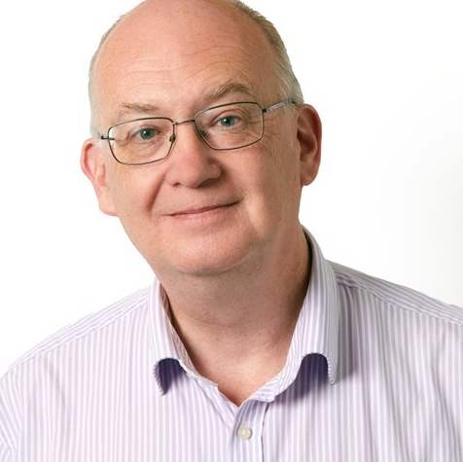
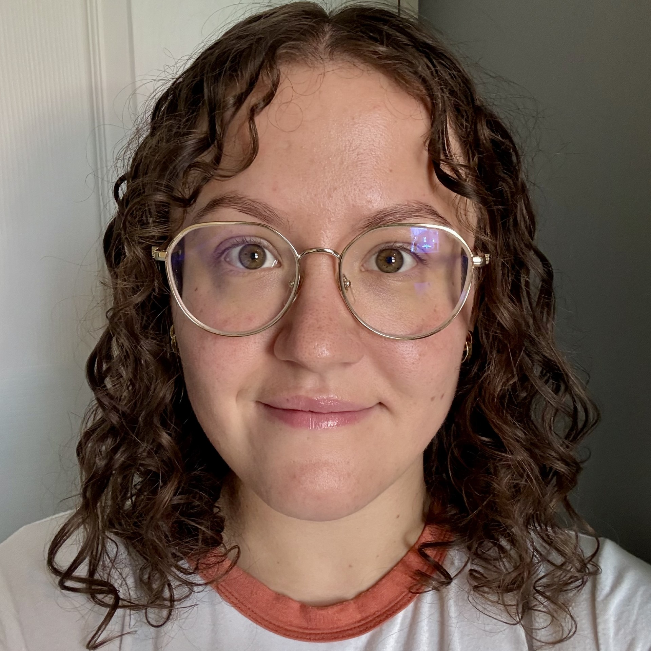
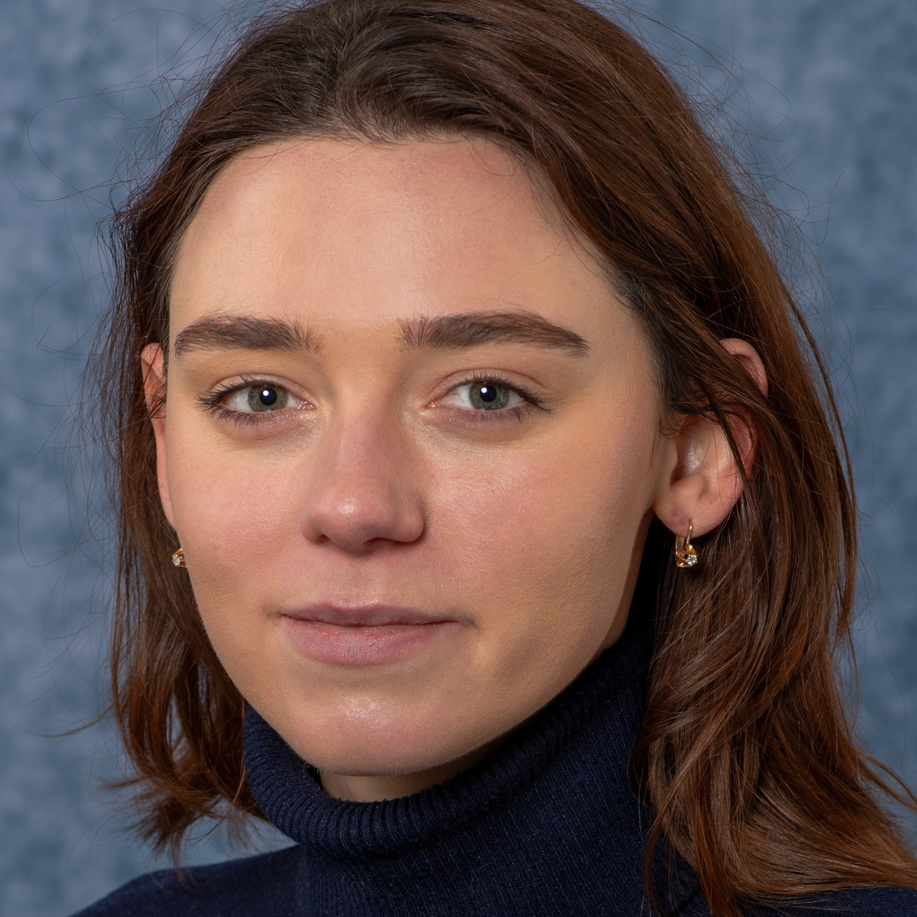
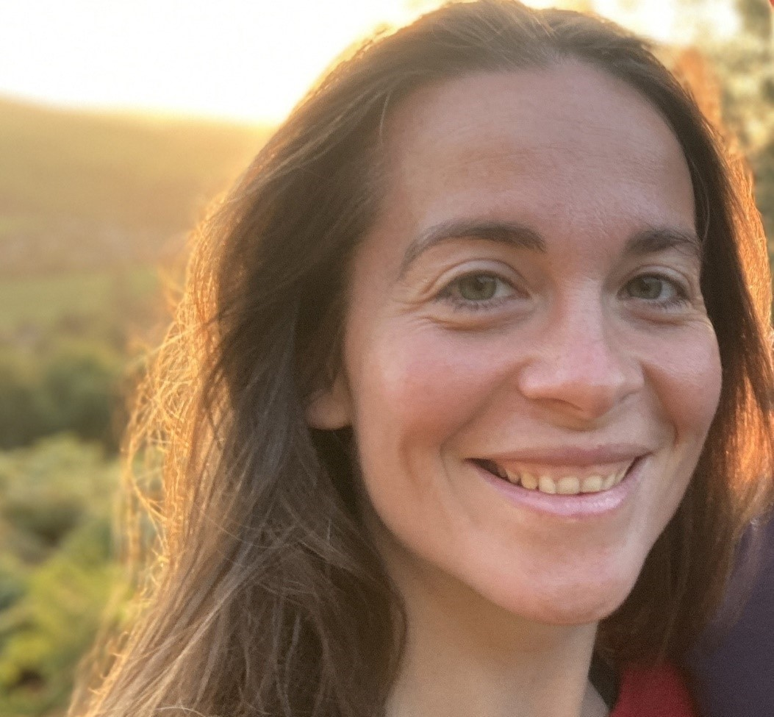
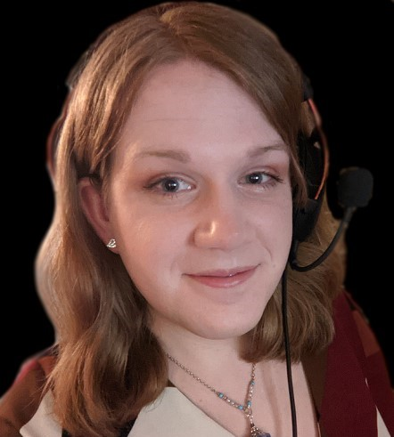
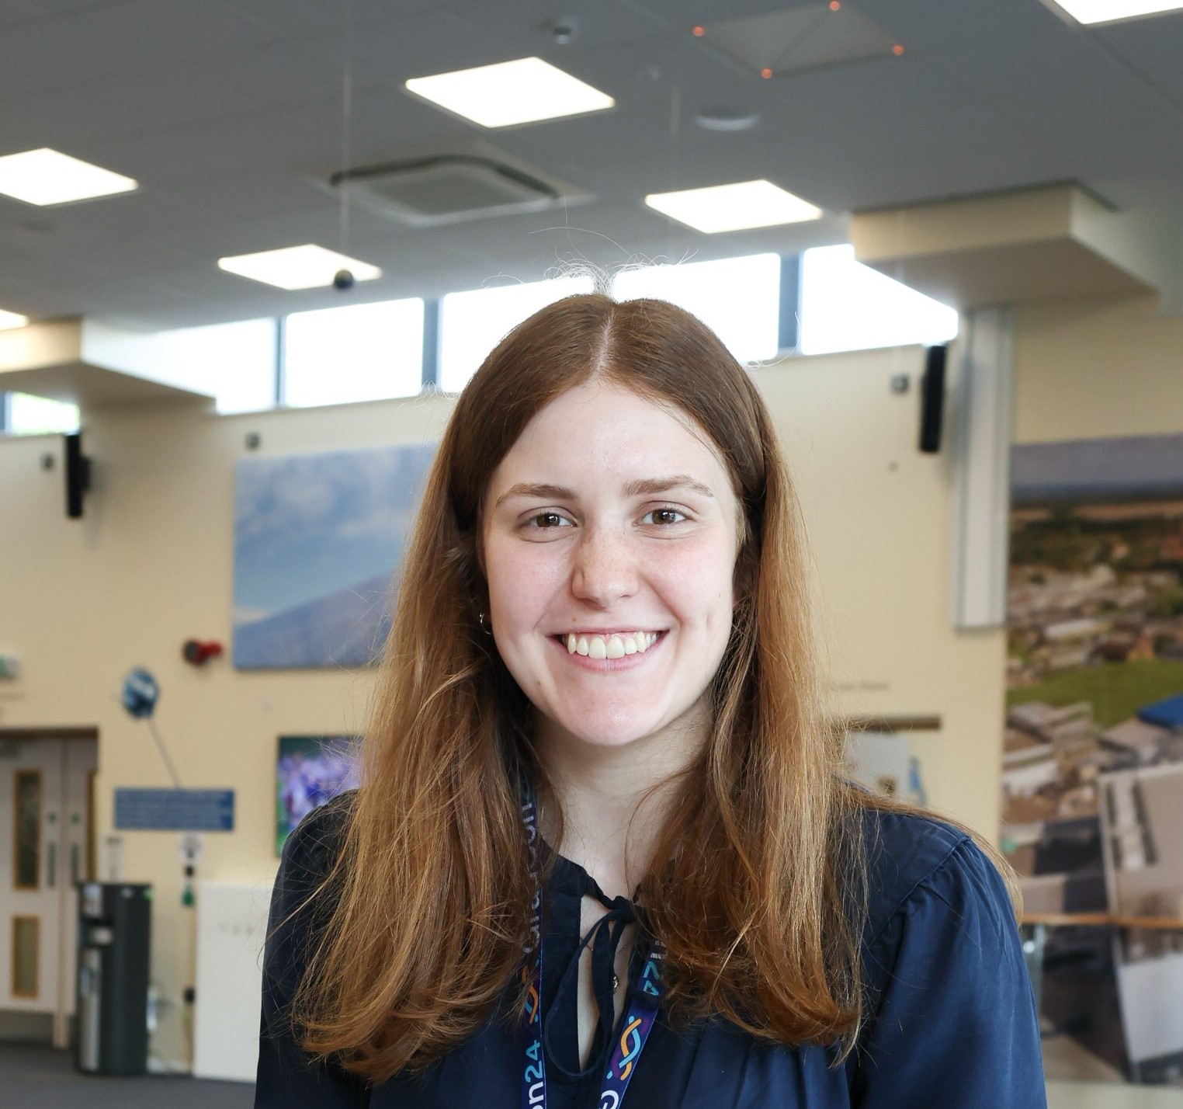
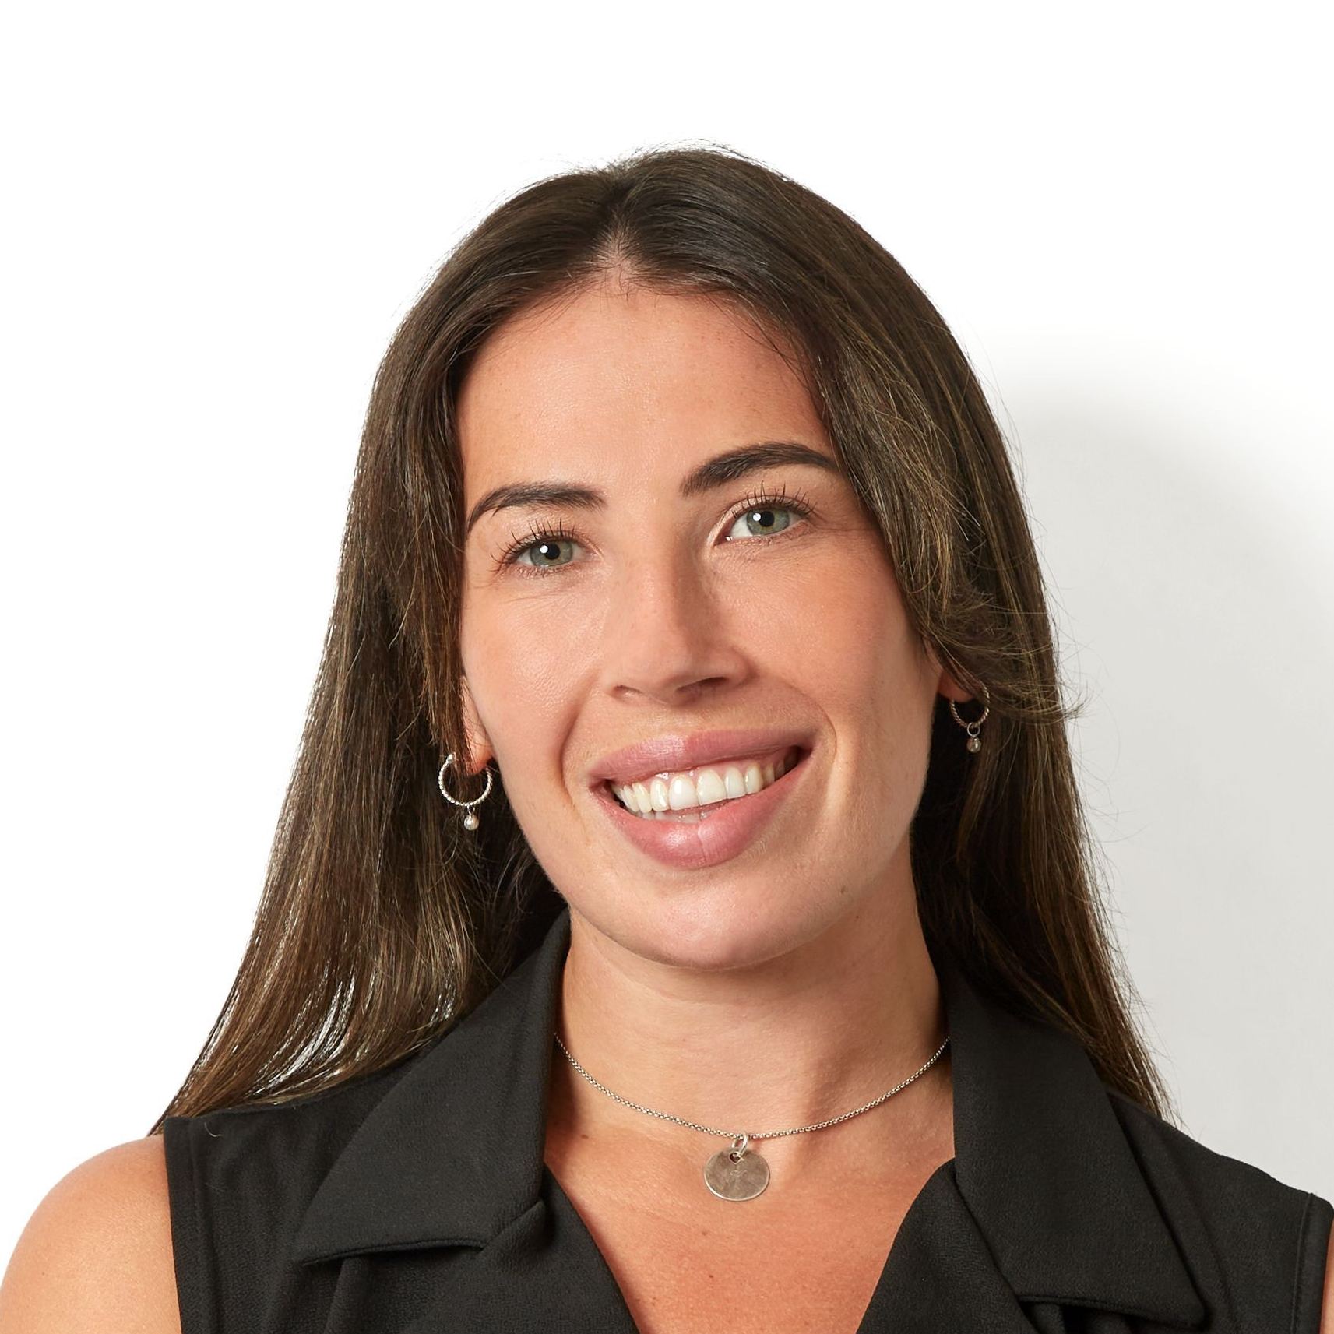

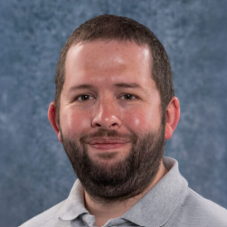
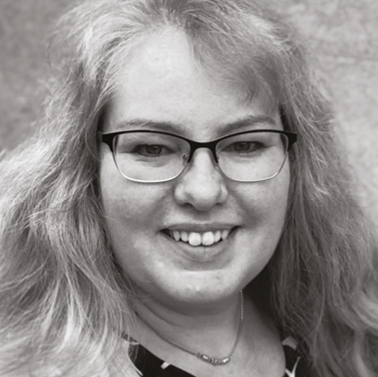
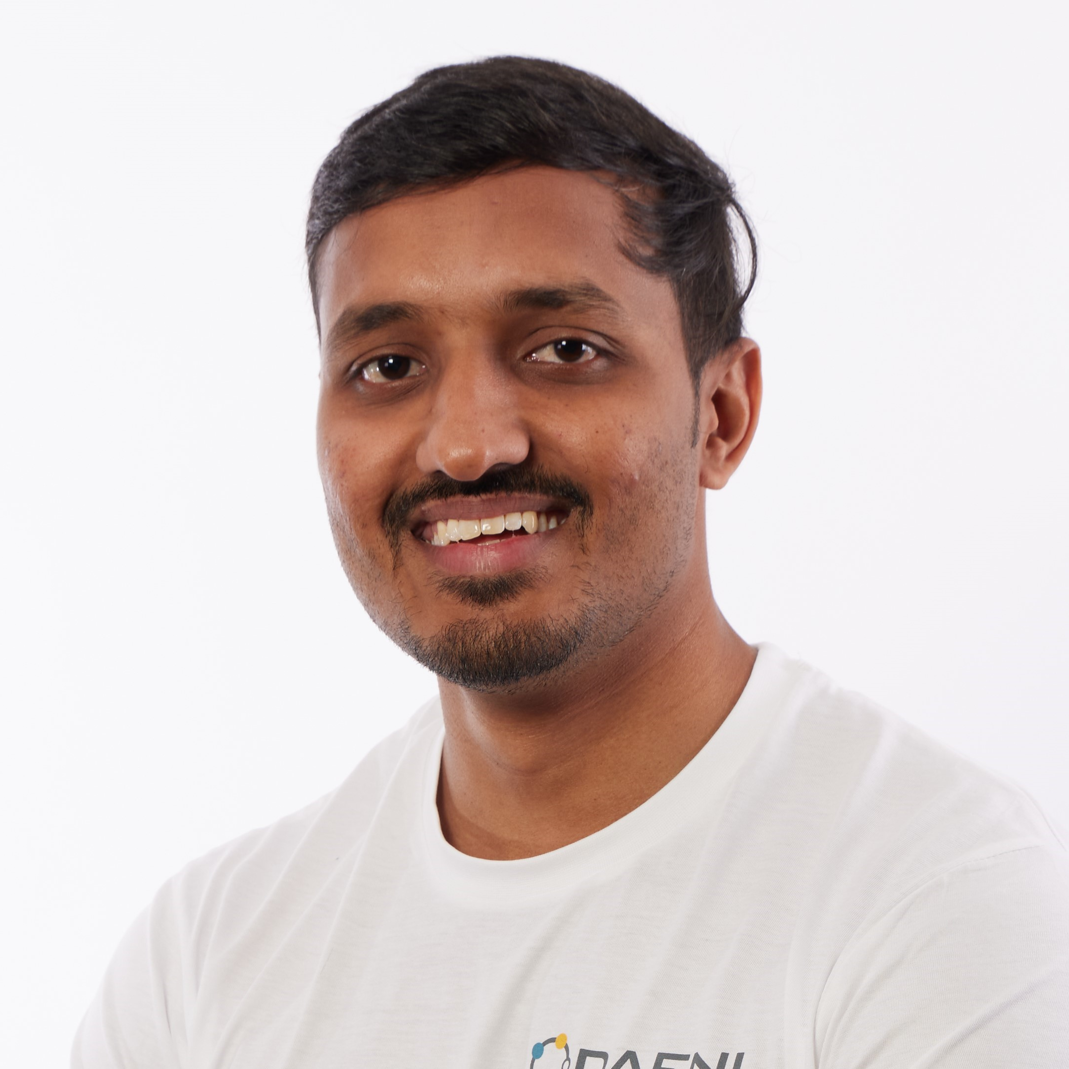
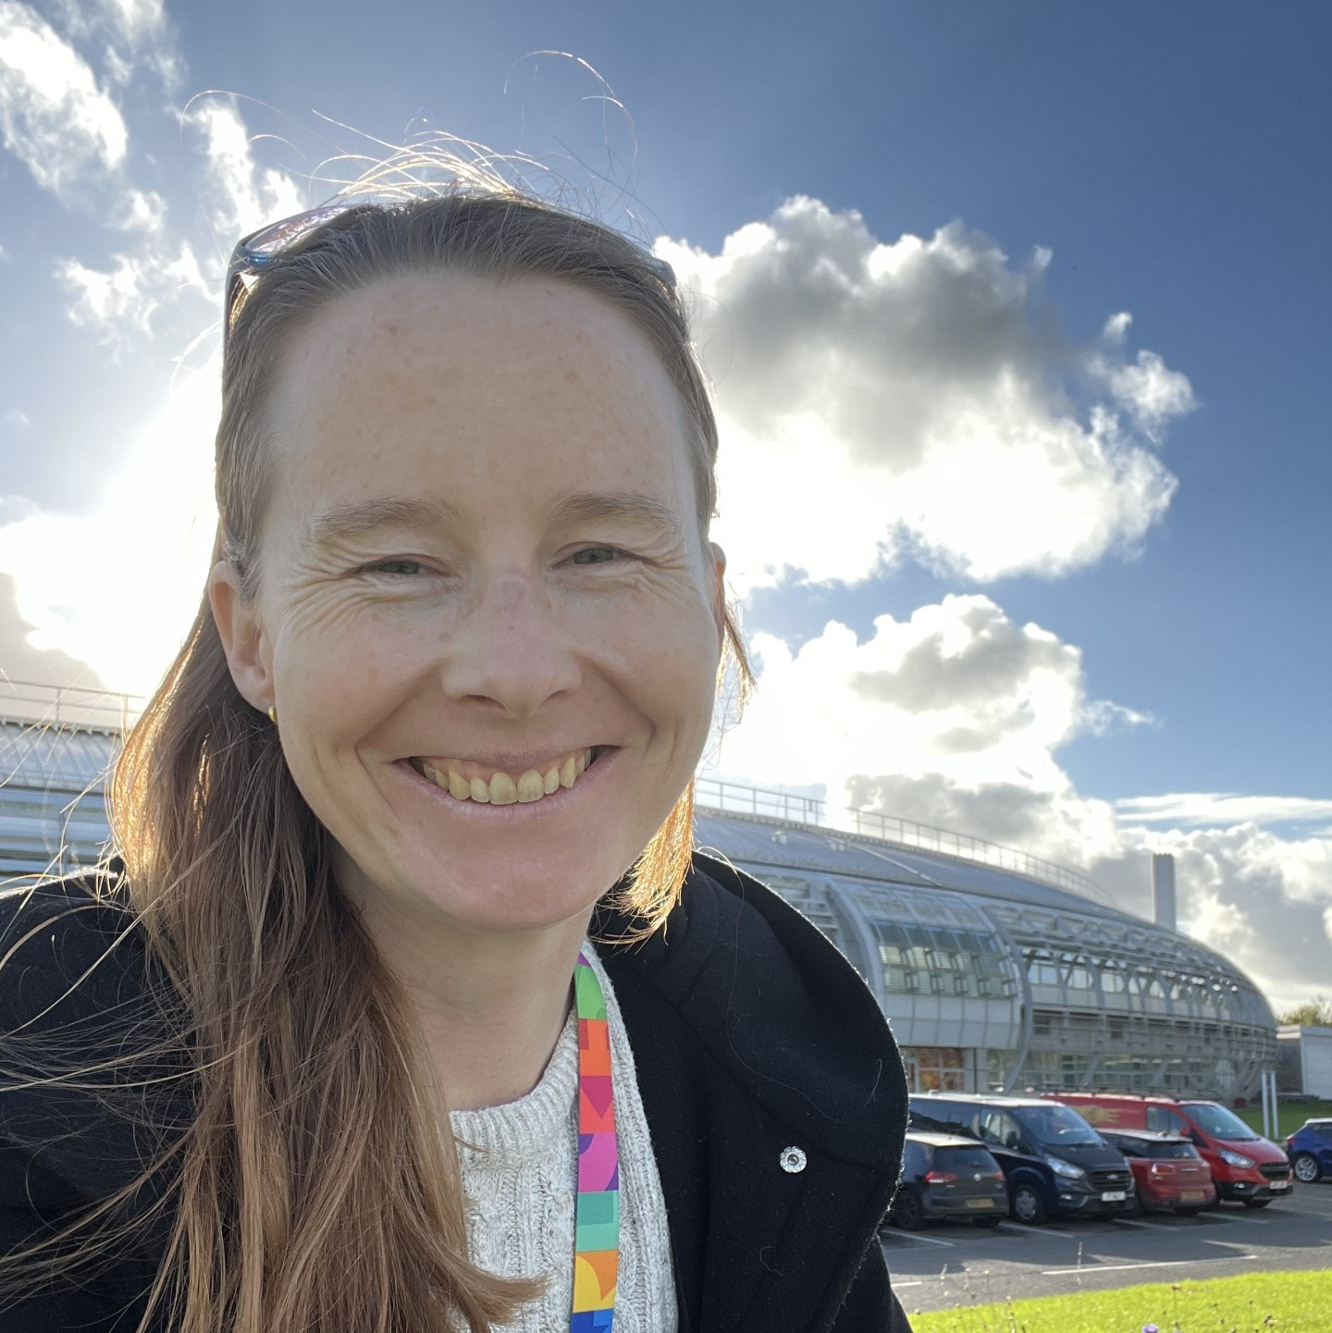
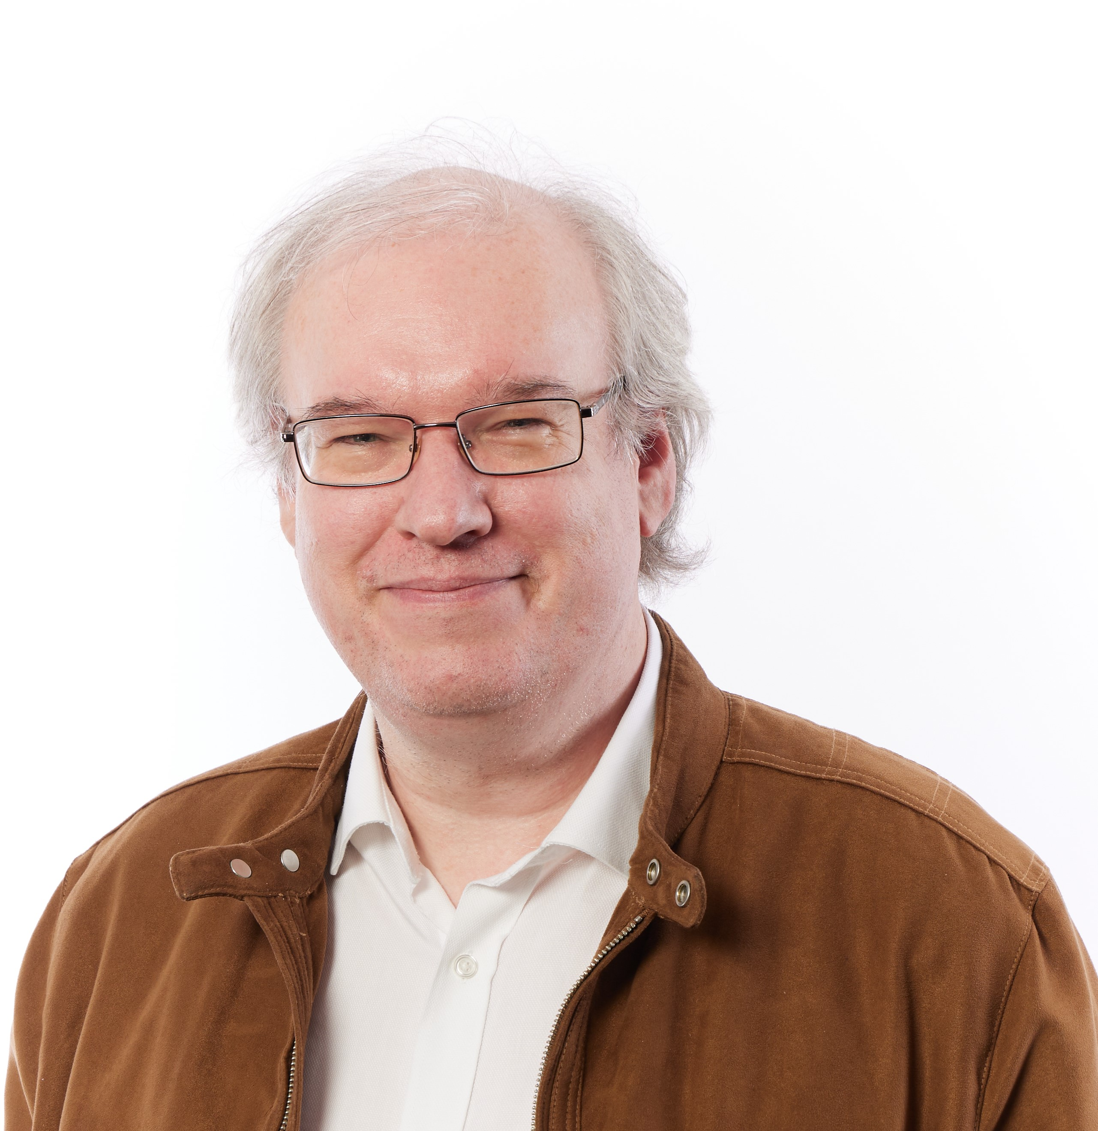
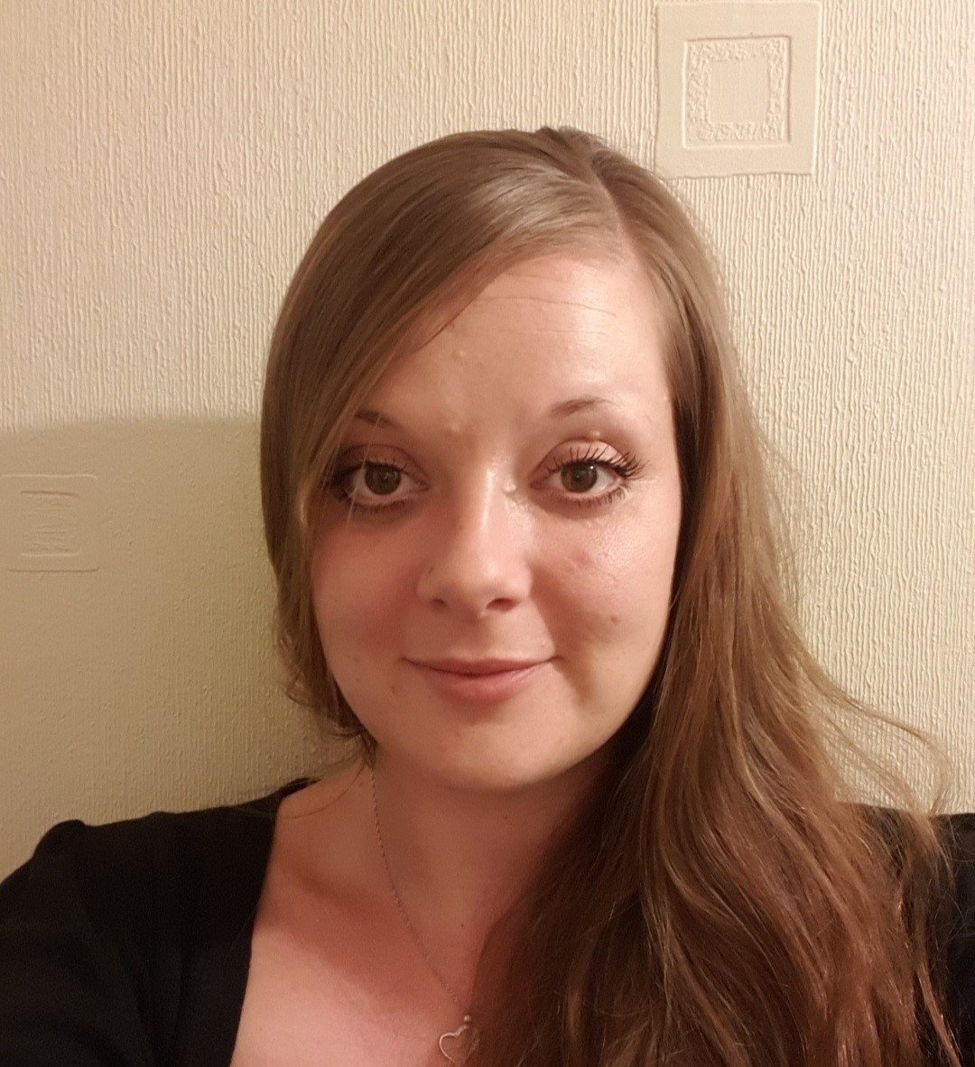
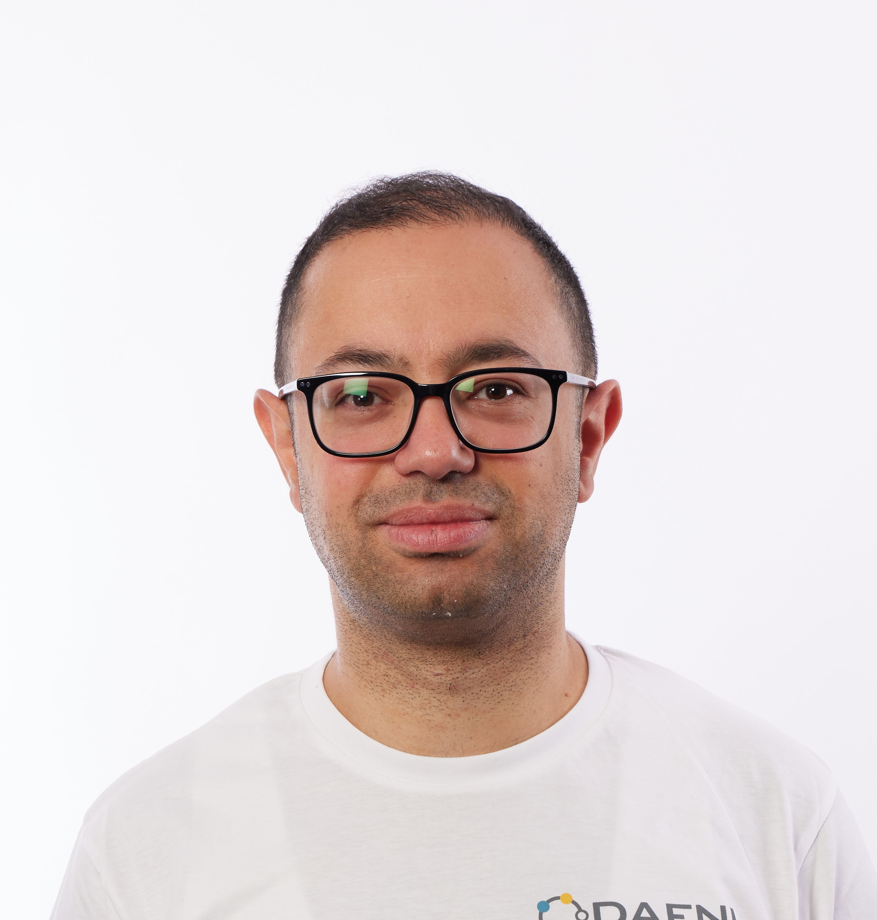
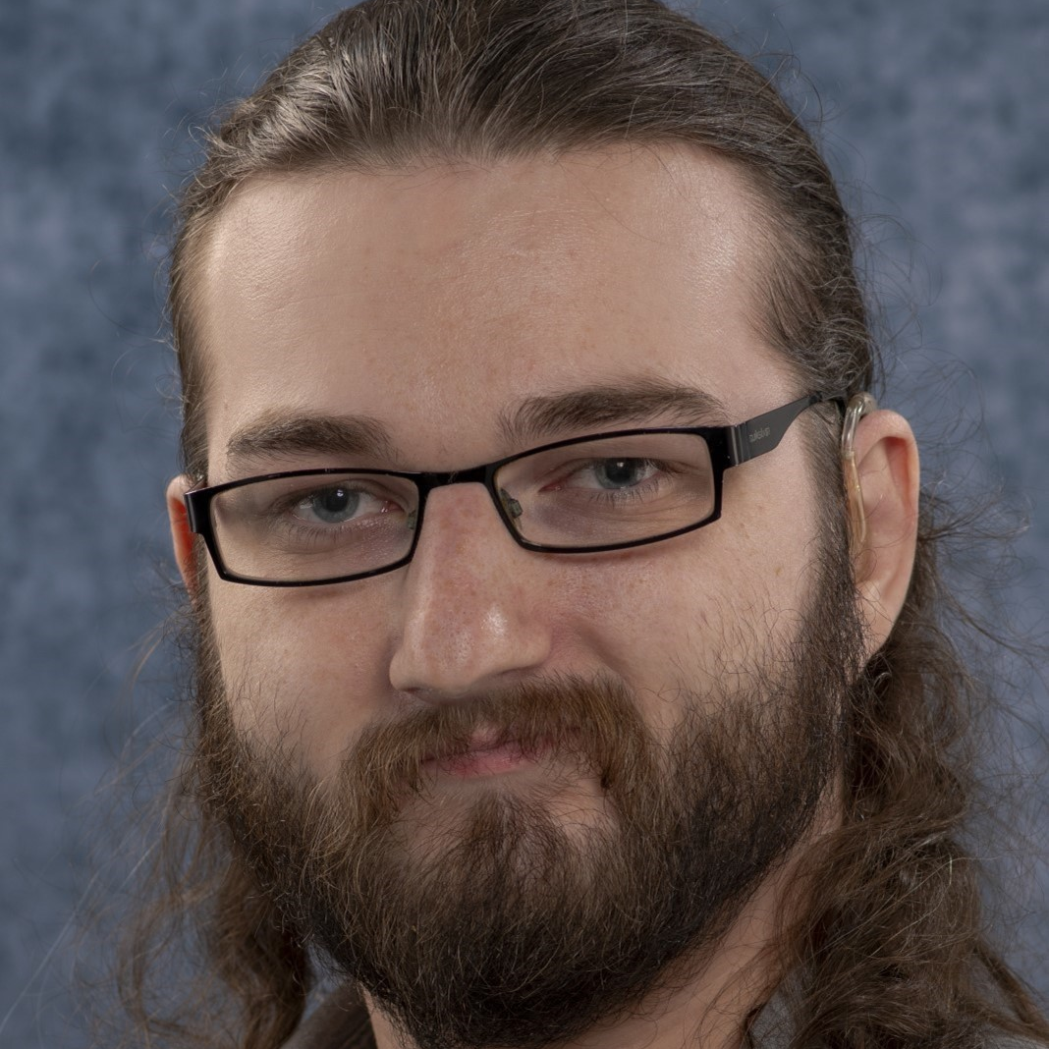
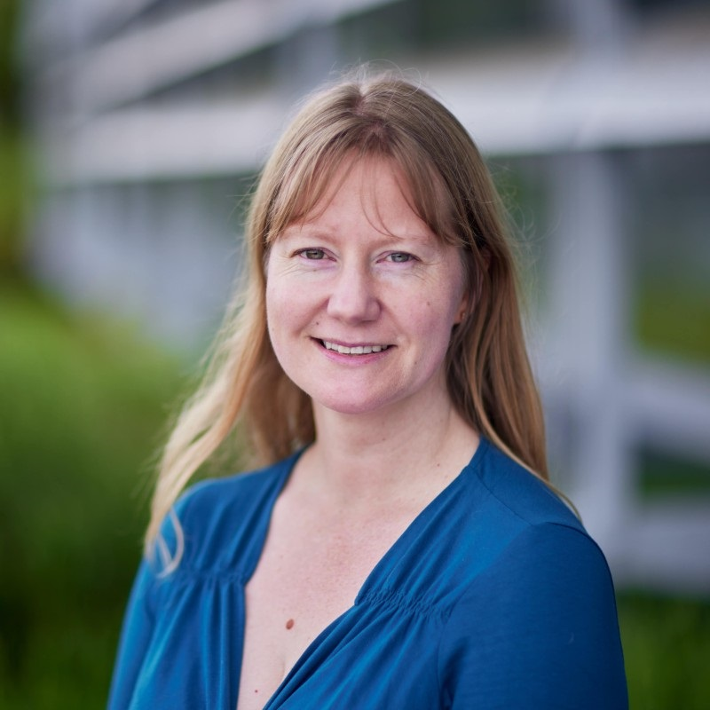
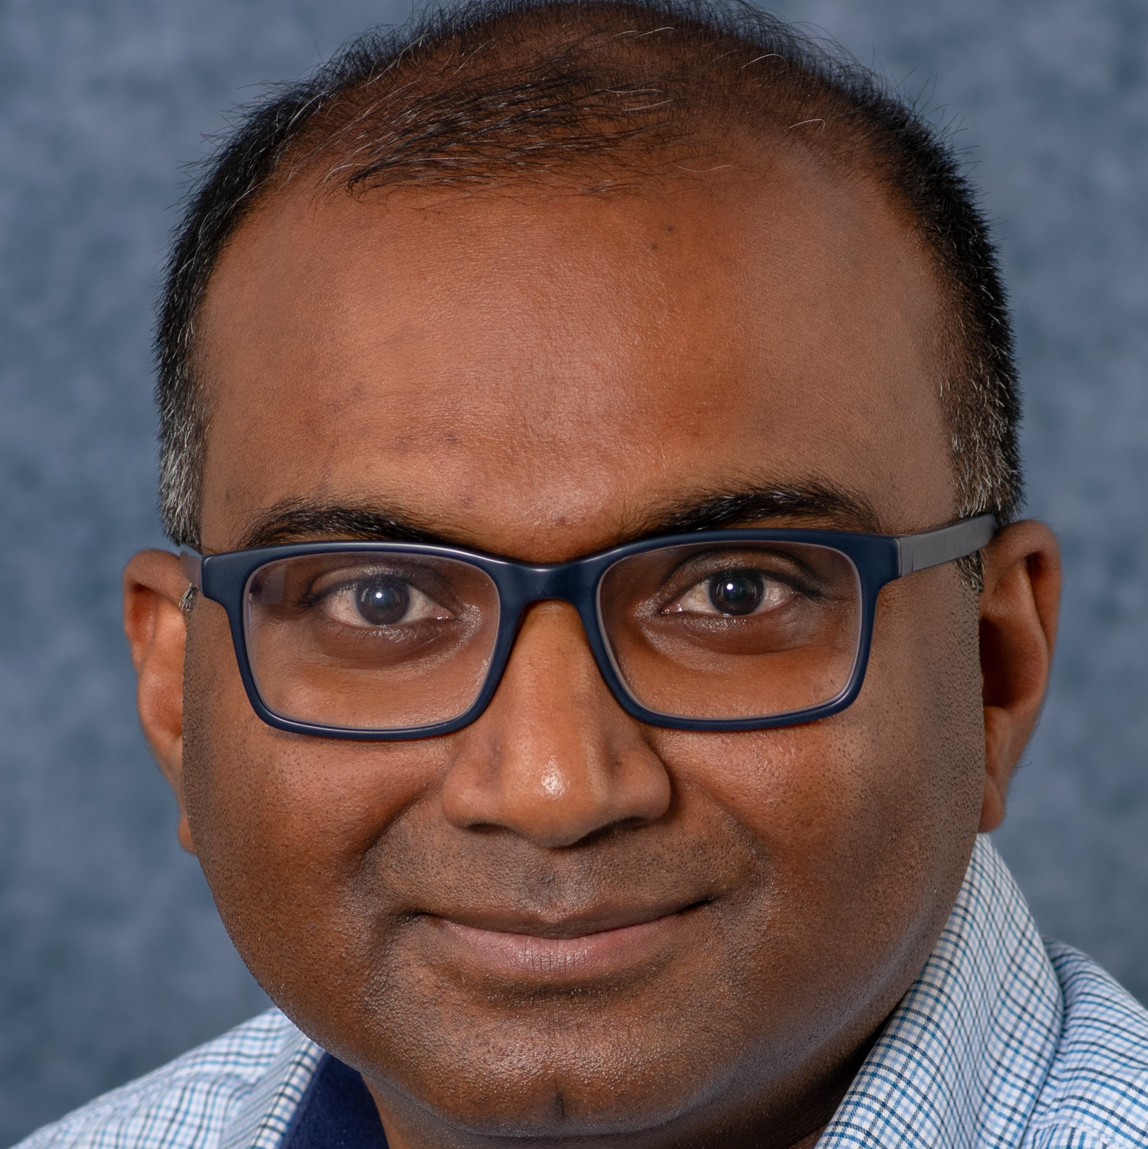
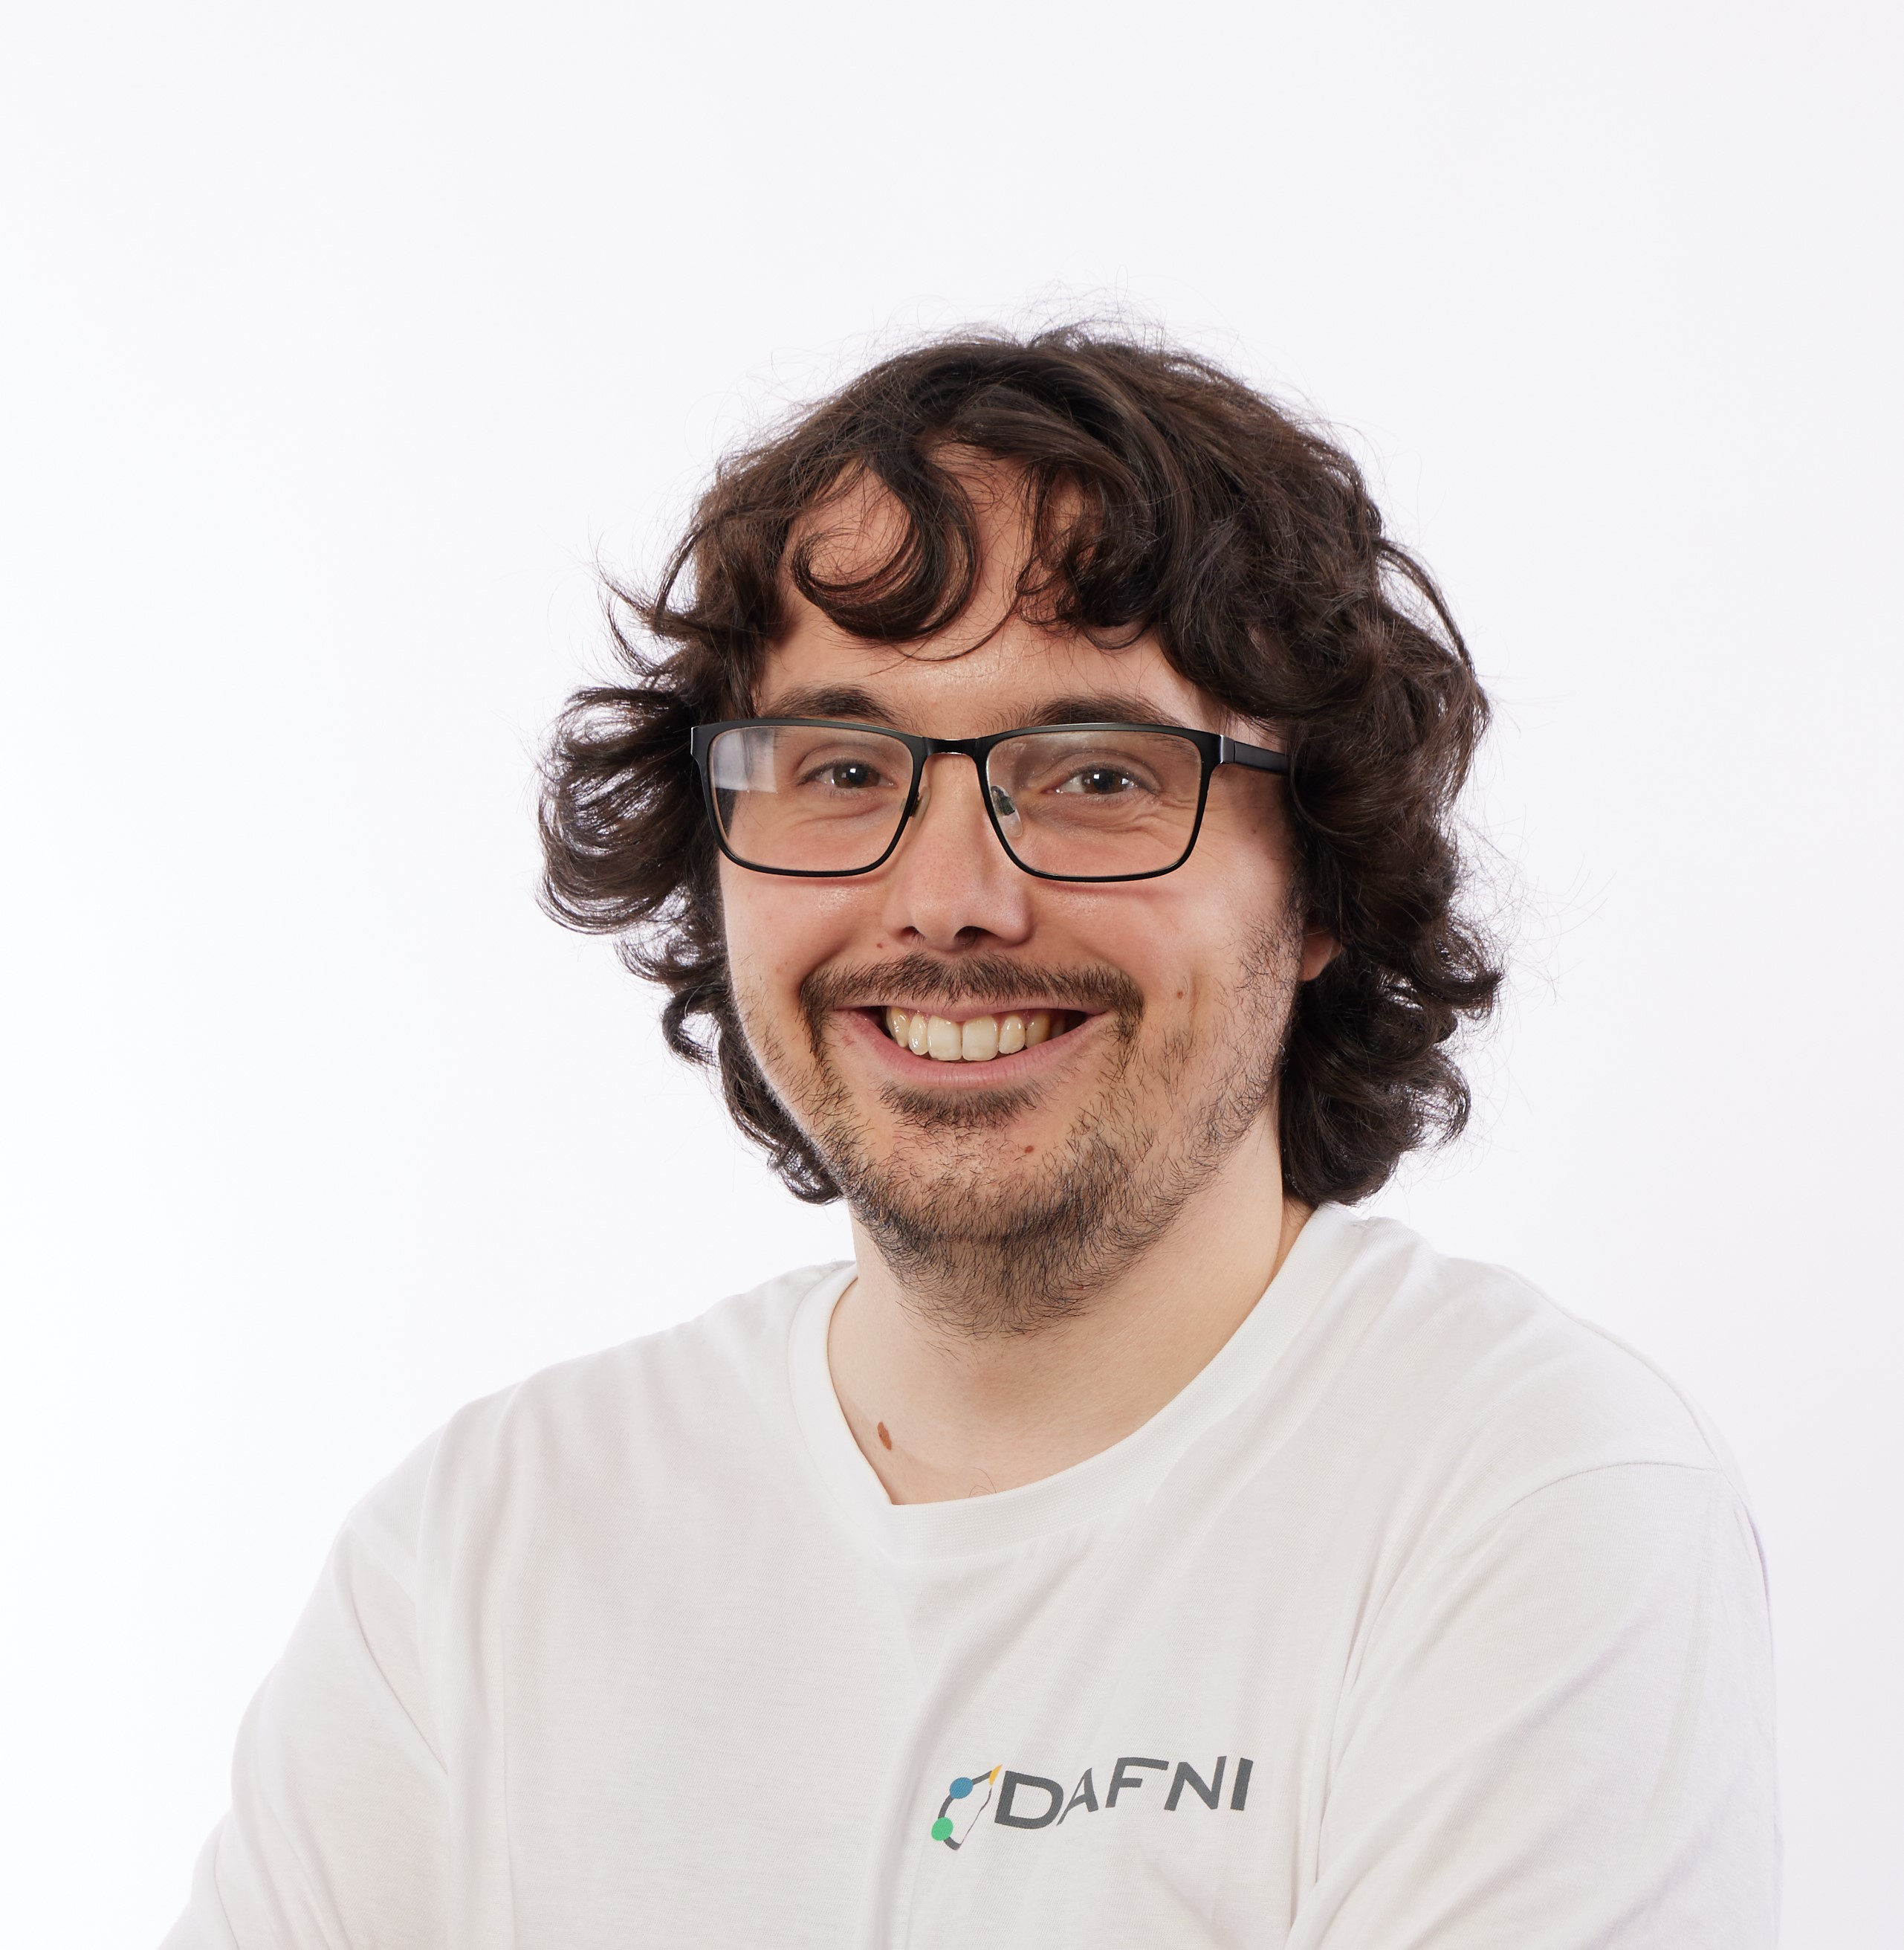

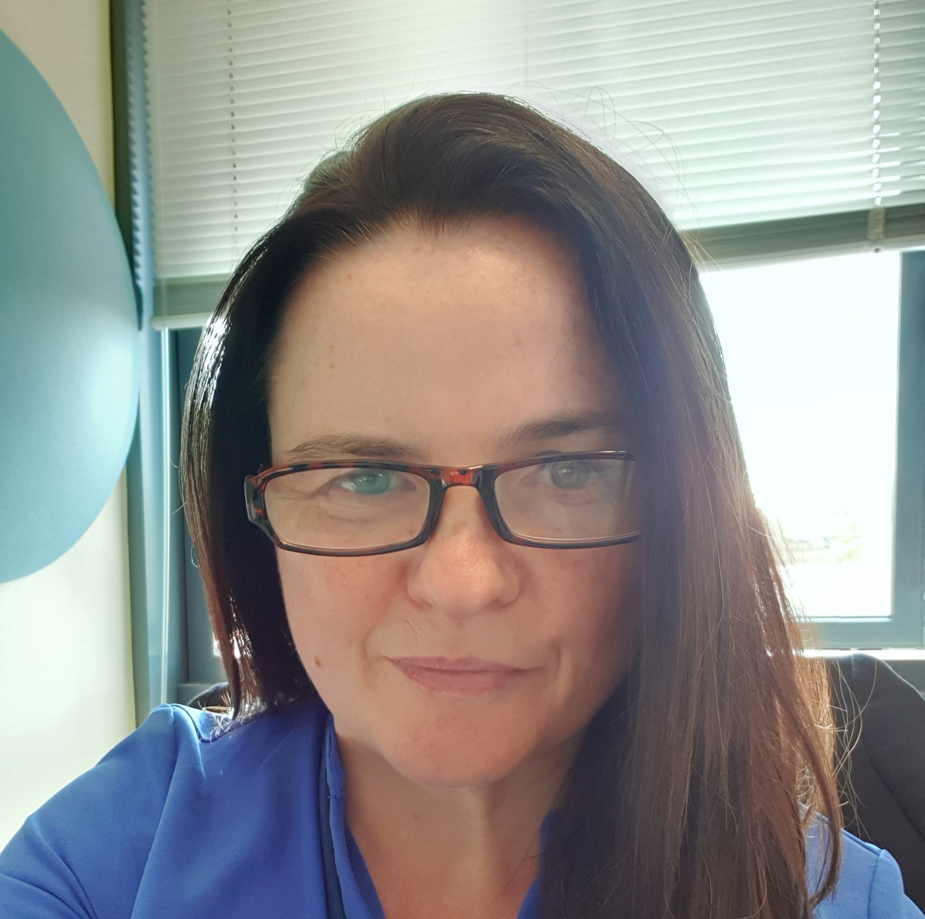
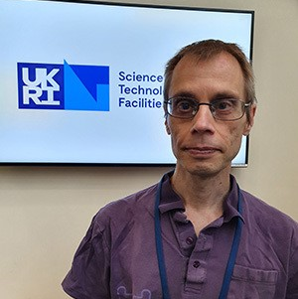

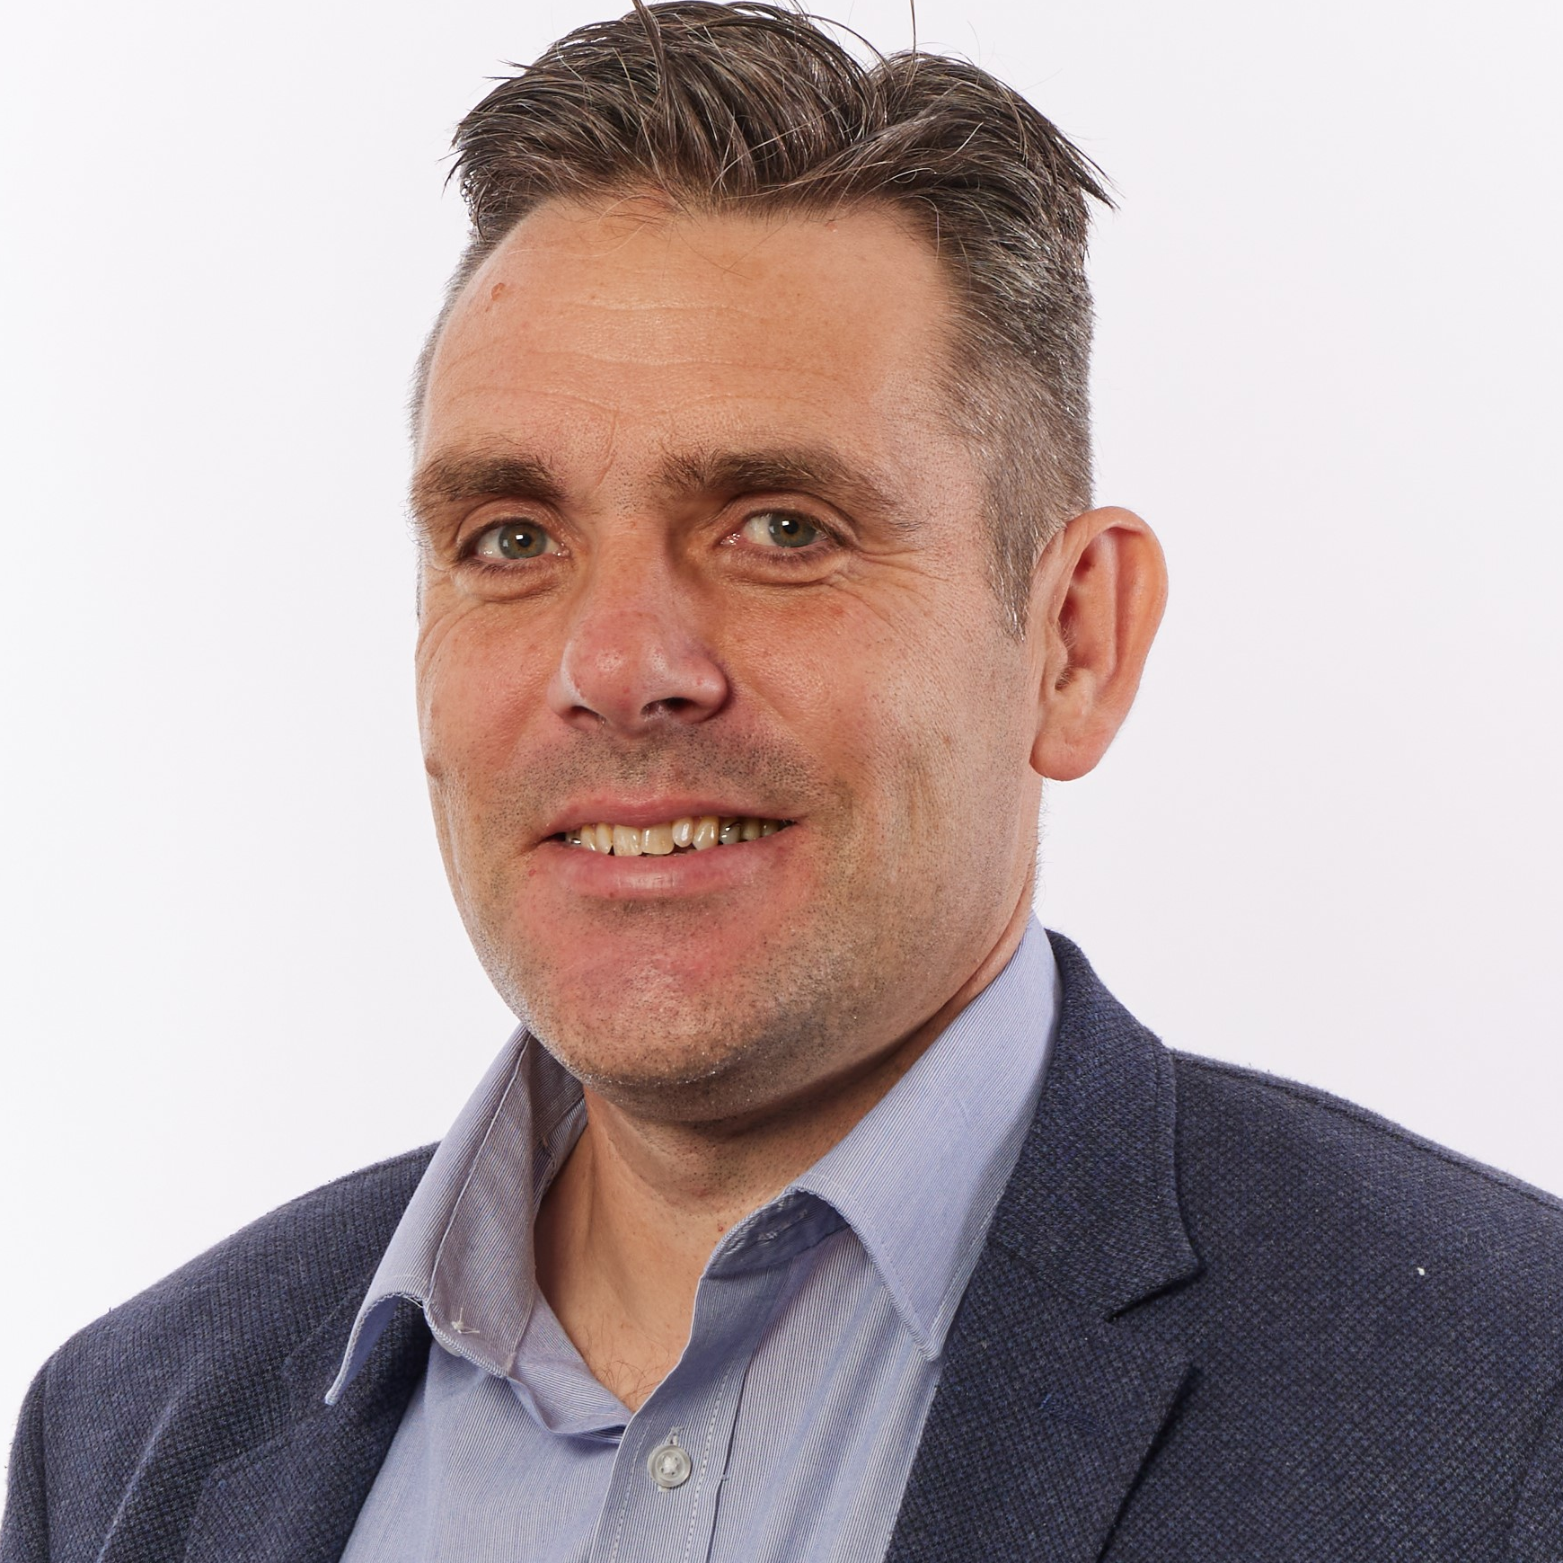

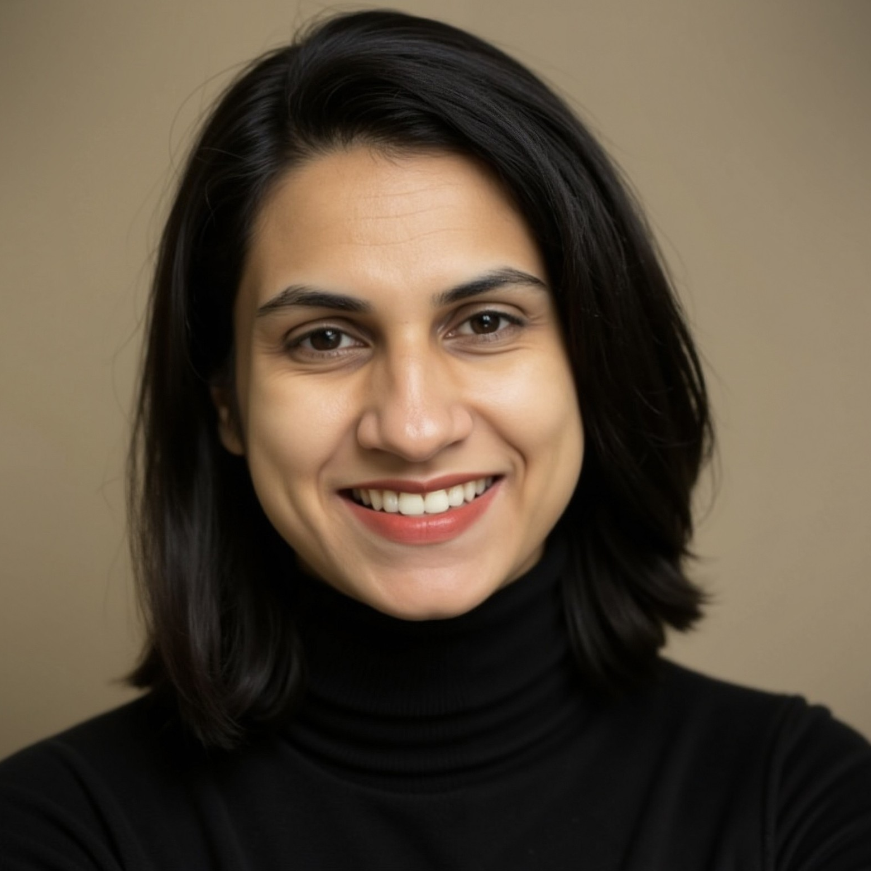
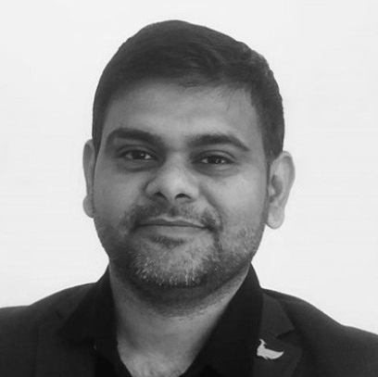
Who are we?
DAFNI Team
Dr. Brian Matthews
Sarah Byrne
Elizabeth Mamtsits
Dr. Bethan Perkins
Rose Dickinson
Lizzie Salmon
Katie Cartmell
DAFNI Programme Lead
Senior Software Engineer / Product Owner
Research Software Engineer & Liaison
DAFNI Group Lead
Senior Software Engineer/ Technical Lead
Scientific Computing Graduate
Delivery Manager
Dr. Lewis Sampson
Mathew Sims
Catherine Dhanjal
Akhil Dubakunta
Teagan Zoldoske
Dr. Kyle Stevenson
Lyndsey Harding
Research Software Engineer
Senior Software Engineer
Media Manager
Software Engineer
Data Curator
User Liaison
Programme Support Officer
Dr. Server Kasap
Jack Haydock
Alison Oliver
Dr. Saiful Khan
Aaron Larkins
Lilith Cole
Marion Samler
DevOps Engineer
Software Developer
Community Research Manager
Senior Data Scientist
Software Engineer
Senior Software Engineer
Business Development Manager
Dr. Jens Jensen
Abhishek Mazumdar
Earl Talavera
Tom Kirkham
James Acris
Karen VanHaltren
Archit Mantry
Data Scientist
Senior Software Engineer
Scientific Computing Graduate
Science Lead
Senior Software Engineer
Data Curator
Project Co-Ordinator

Slide 5
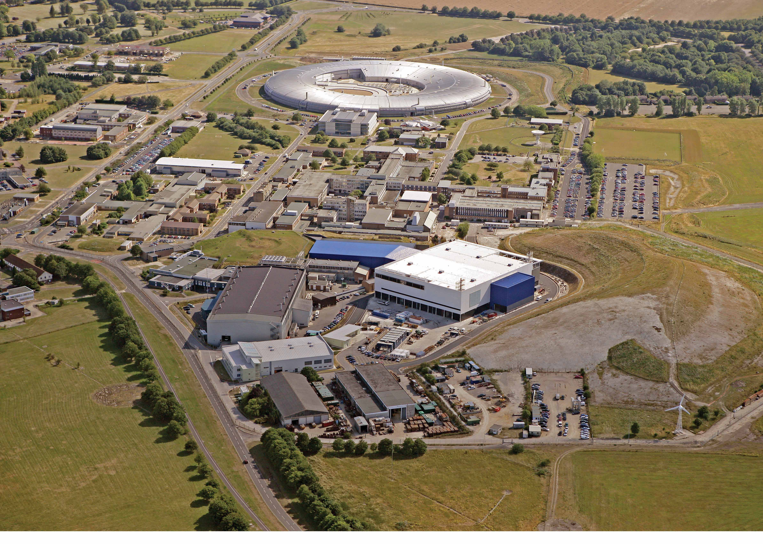
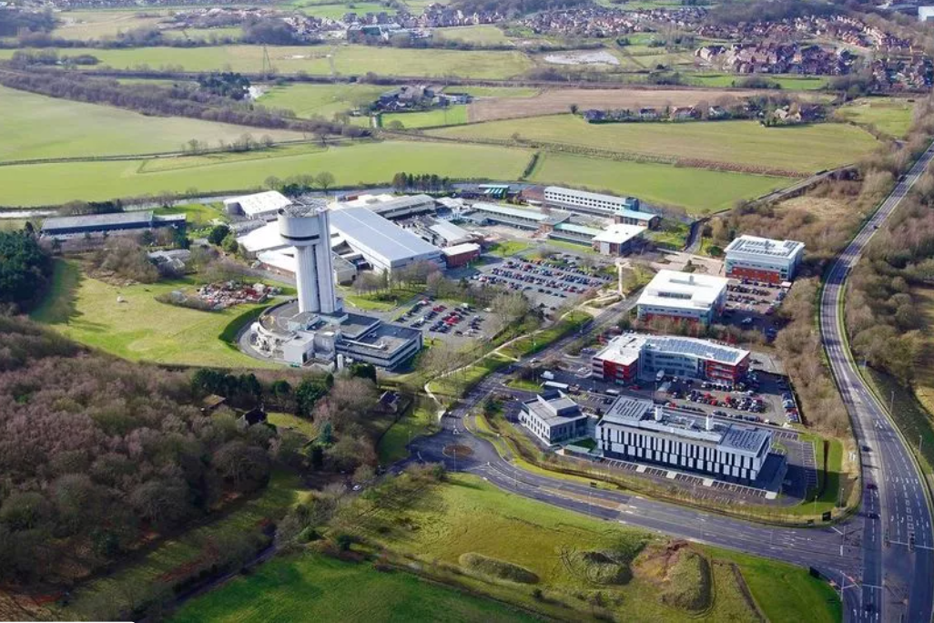
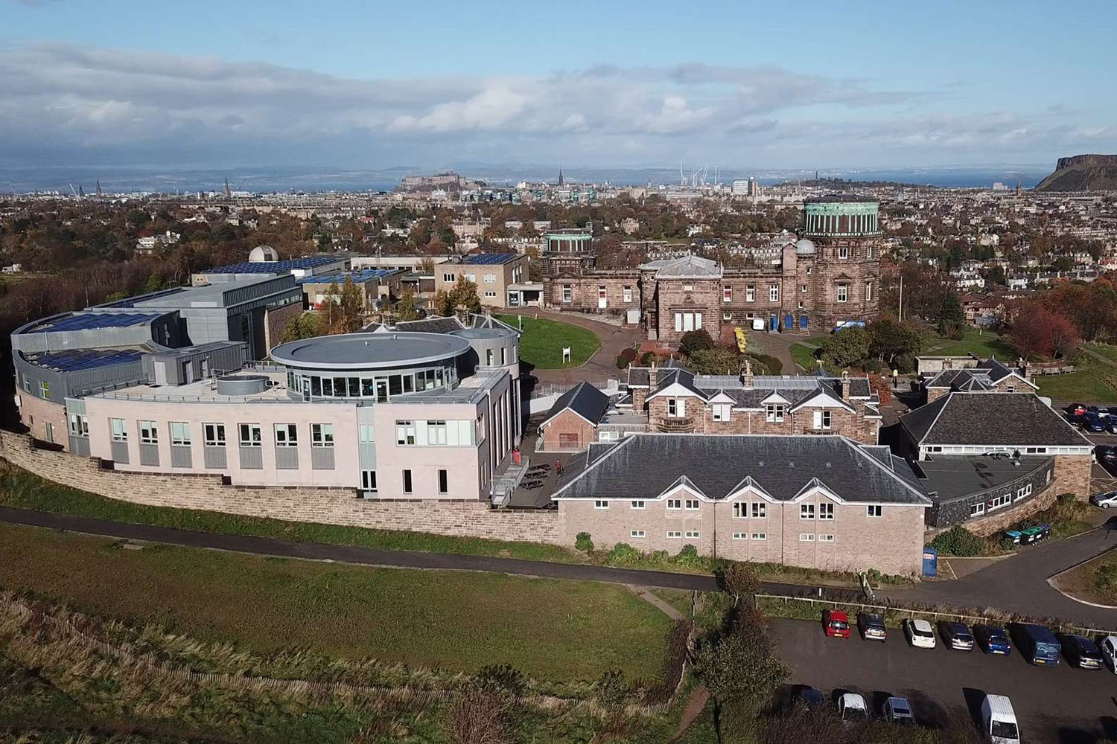

DAFNI at STFC
Daresbury Laboratory
Rutherford Appleton Laboratory
UK ATC

Slide 6
The DAFNI platform

Slide 7

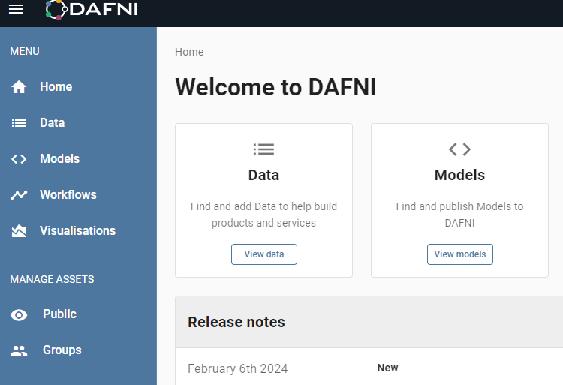
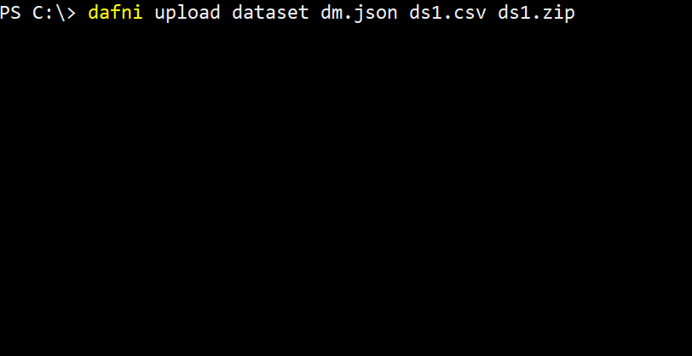



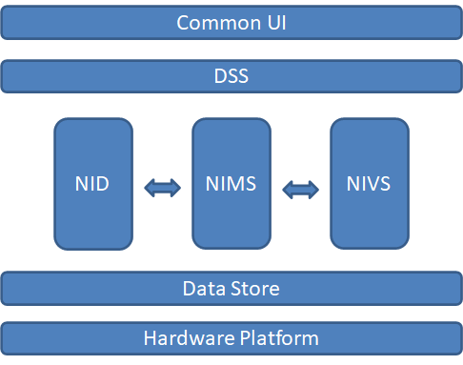
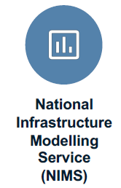
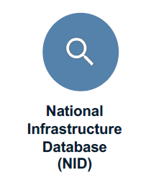

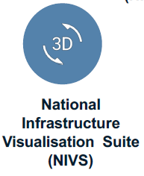
DAFNI Architecture
Is used for managing the DAFNI cluster, handling the deployment of Docker containers, and the allocation of computing resources.
Graphical Front End
Command Line Interface
(& Keycloak)
Docker is a container technology that allows DAFNI to deploy and run software packages.
Notes:
Recommended replacement for previous slide

Slide 8
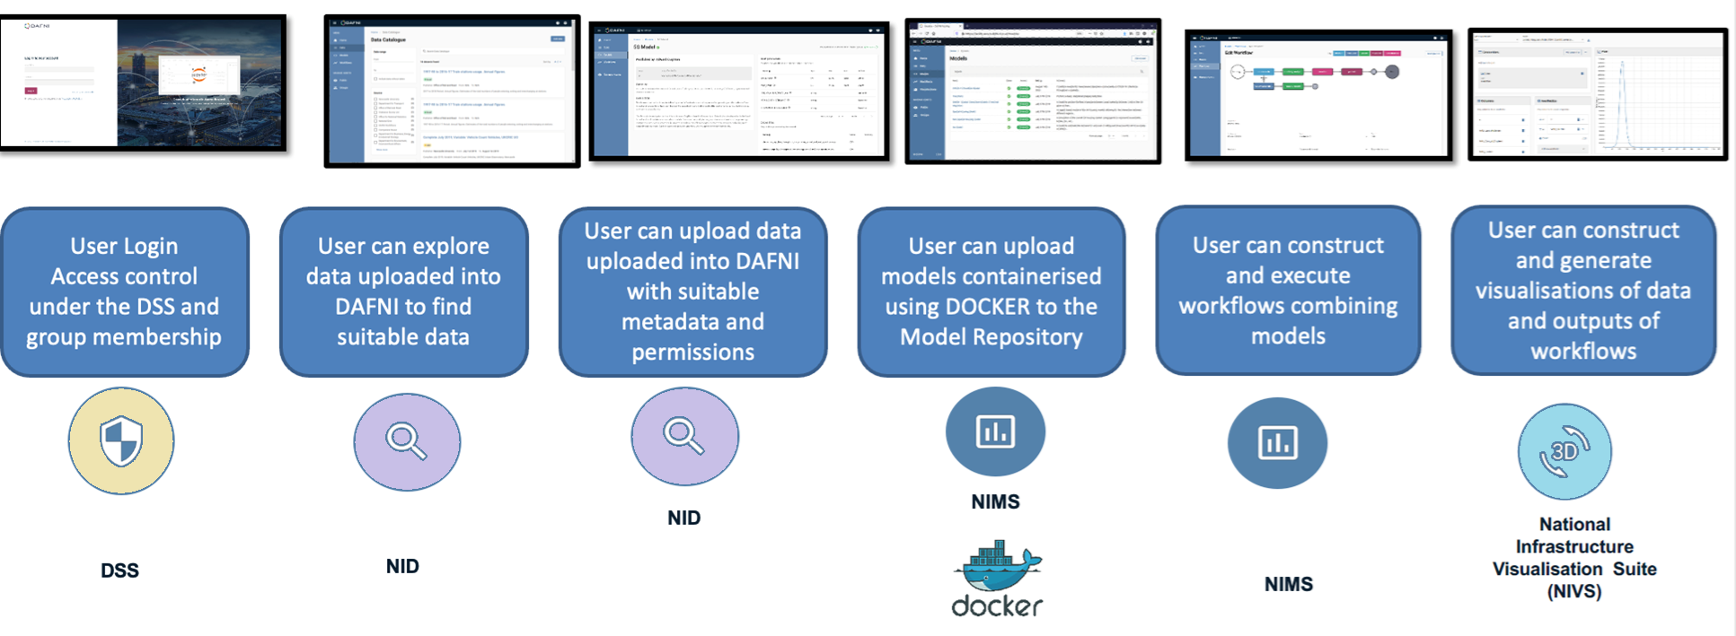

DAFNI Architecture : Overview
National Infrastructure
Database
DAFNI Security Service
National Infrastructure
Modelling Services
Notes:
Recommended replacement for previous slide

Slide 9
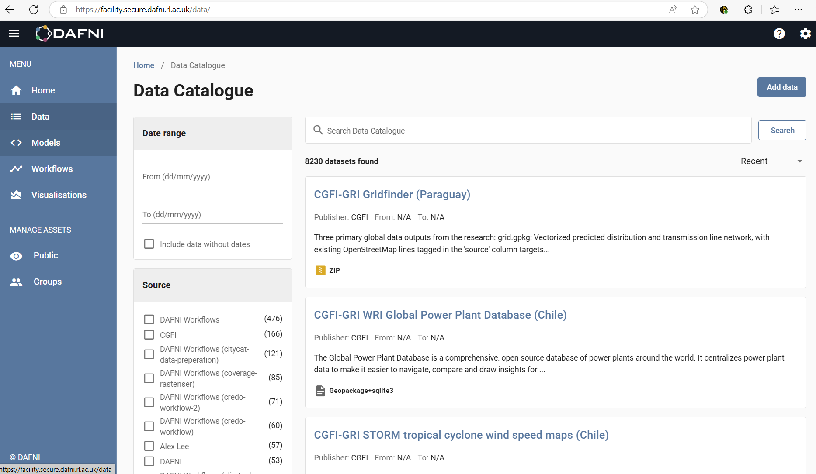
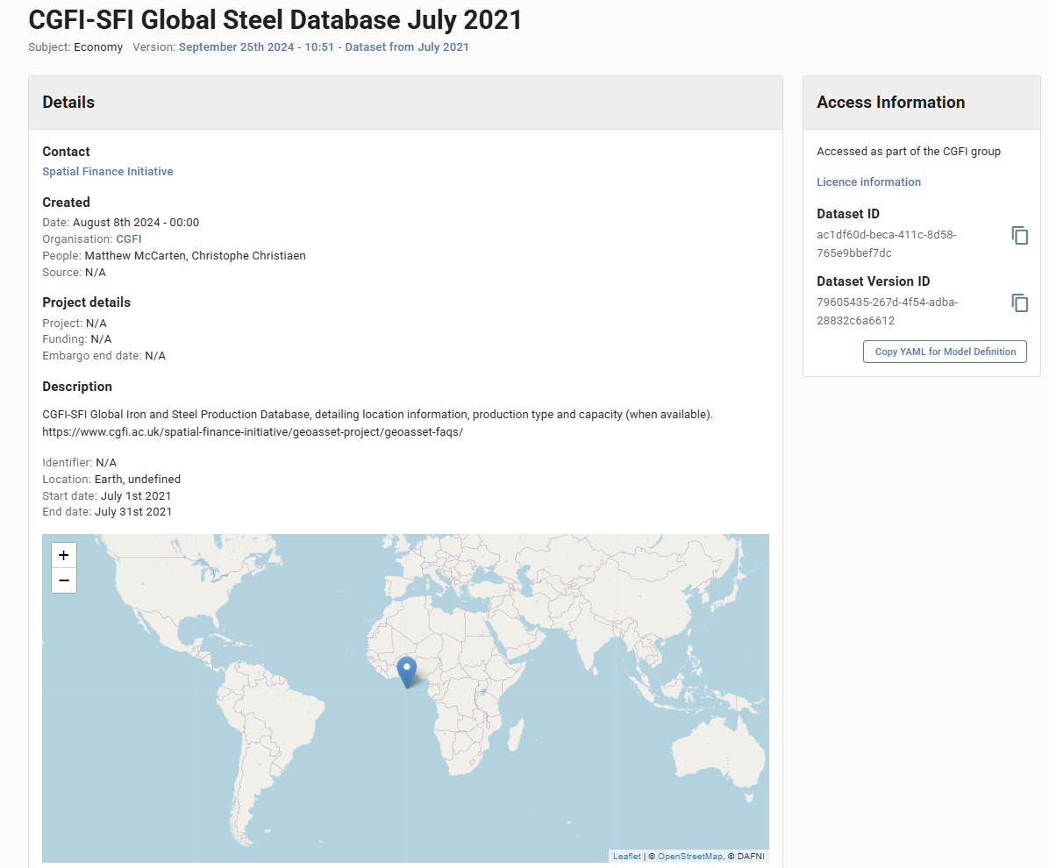

National Infrastructure db
The National Infrastructure Database (or NID) provides DAFNI with the capability to handle a large searchable catalogue of data. This data can be either public or private in DAFNI, and can be shared within groups as needed.
Users are given the ability to upload, publish and use all DAFNI data available to them in models and workflows.
The NID also handles the associated metadata, used in searches.
Notes:
Recommended replacement for previous slide

Slide 10
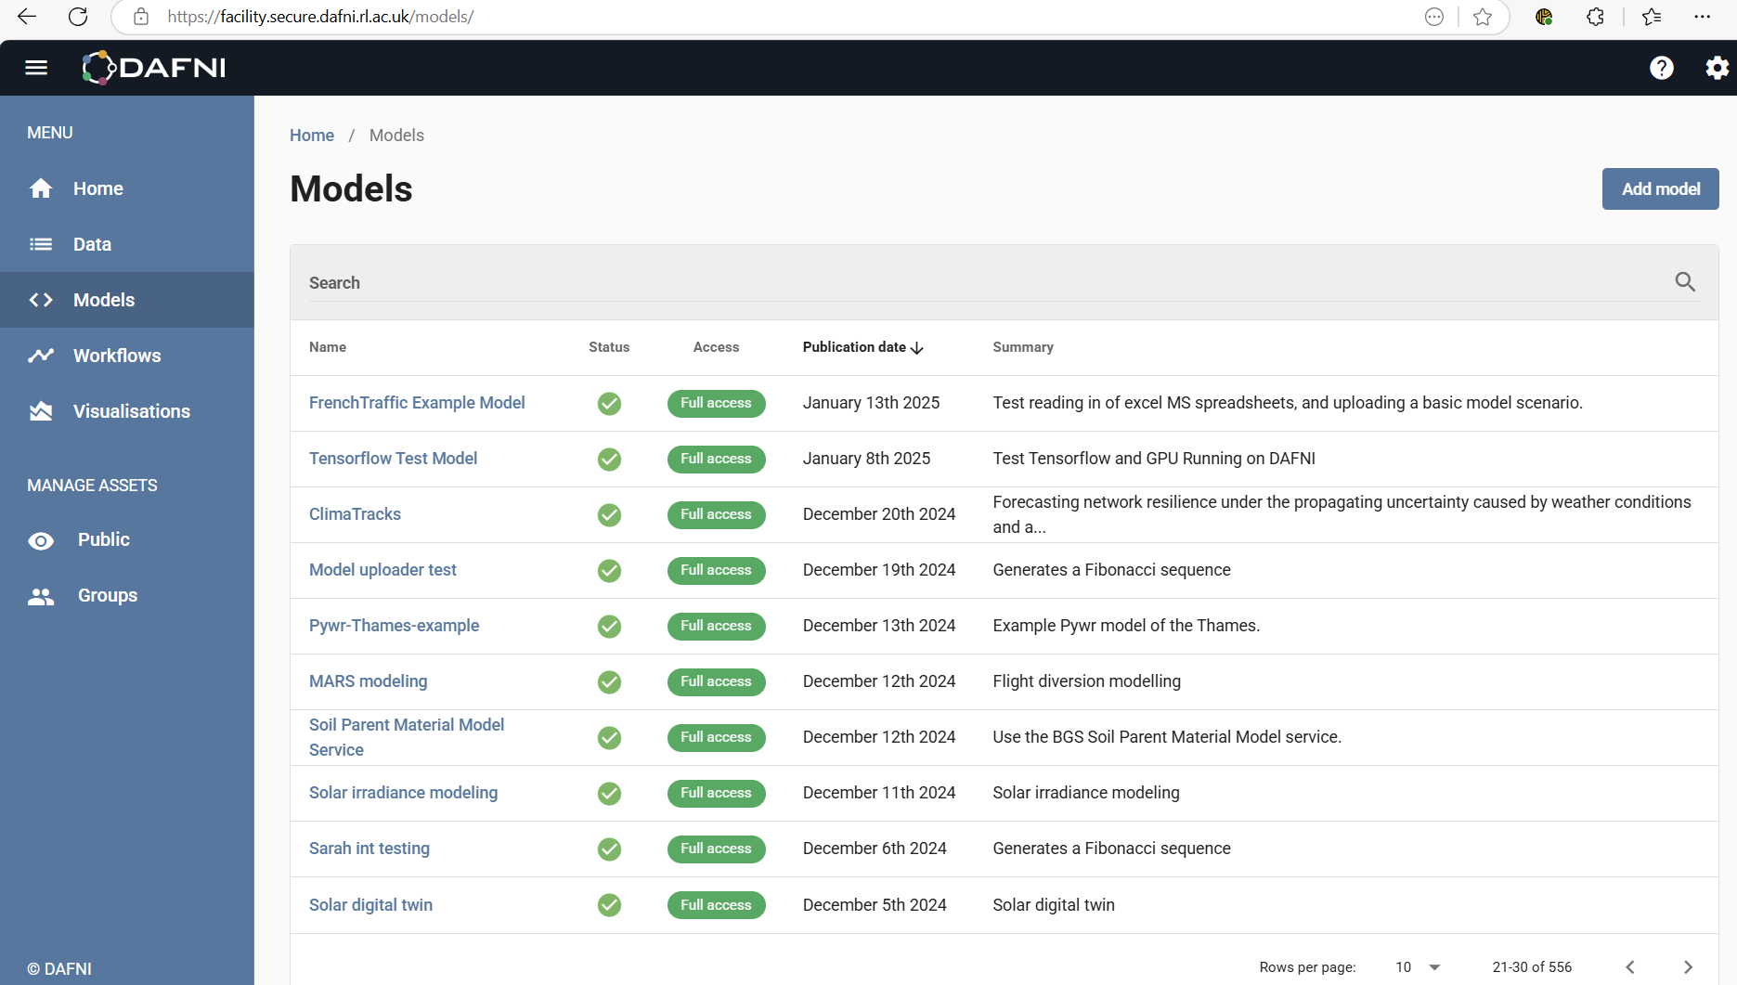
NIMS : Supporting User Models
Models – which could be written in a variety of computing languages - can easily be uploaded into the National Infrastructure Model Service (or NIMS). Like the data (NID) stored in DAFNI, models are also indexed with metadata for searchability.
Models can be run on the DAFNI kubernetes cluster, taking full advantage of model dockerisation, and can access the data stored on DAFNI, in a straightforward manner.
Notes:
Recommended replacement for previous slide

Slide 11
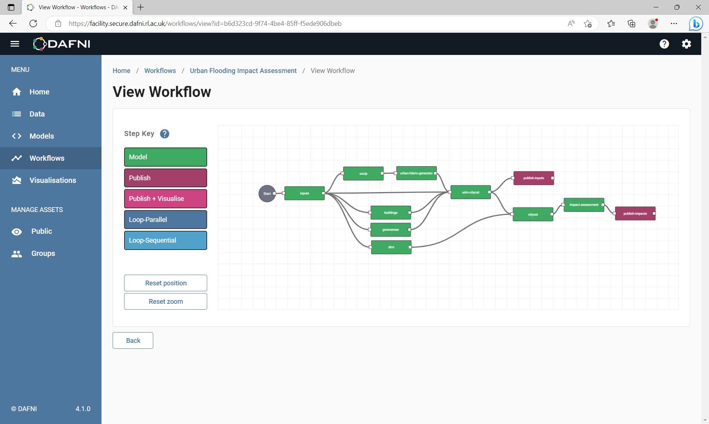
NIMS : Workflows
Models in DAFNI can be joined together to form workflows in a flexible manner. Workflows can also contain loop elements, and models in general can run in series or in parallel.
The drag and drop interface allows workflows to be easily constructed and edited later.
Models can be shared between workflows, within access limits (which are controlled by the model, and data owners).
Notes:
Recommended replacement for previous slide

Slide 12
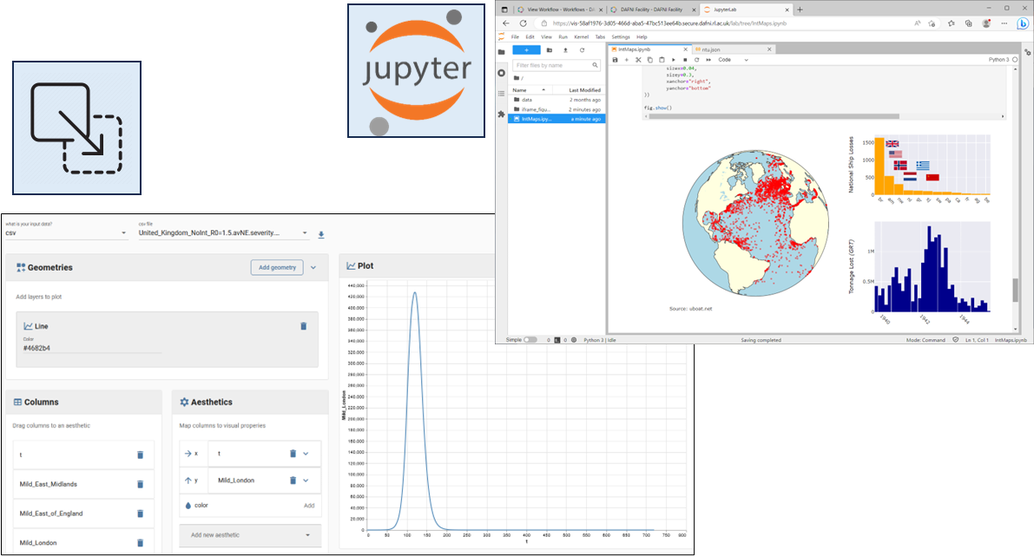
NIVS : Building Visualisations
The National Infrastructure Visualisation Service (or NIVS) allows us to visualise, understand and further analyse data from workflow outputs.
In DAFNI we currently support two different classes of visualisation.
A straightforward drag & drop tool, and Jupyter notebooks (python & R scripting).
Notes:
Recommended replacement for previous slide

Slide 13


How DAFNI is being used

Slide 14

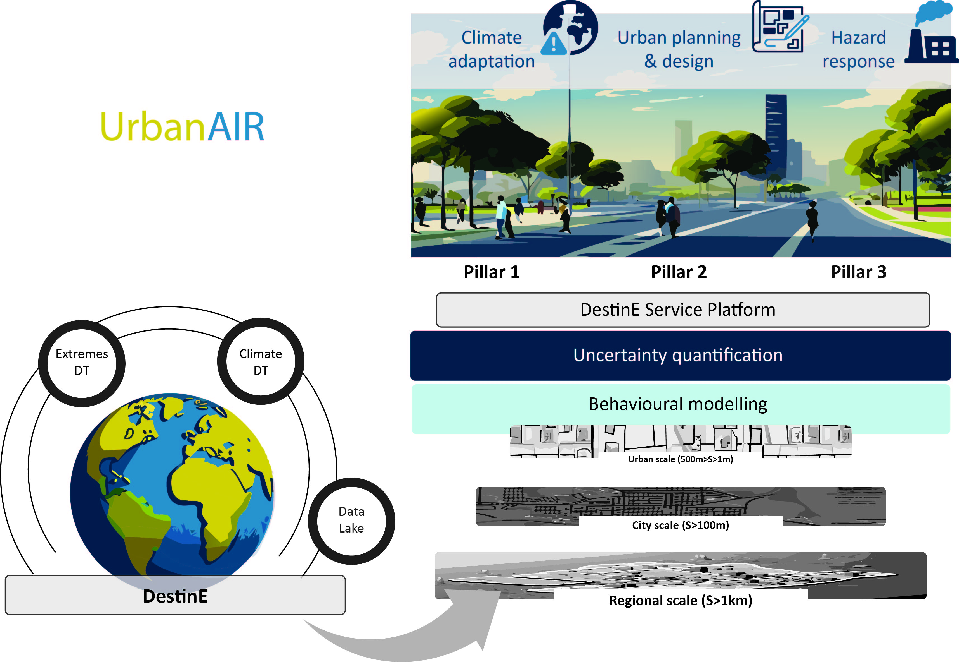


UrbanAIR overview
Urban Simulation for Air Quality and Heat Resilience Strategies
UrbanAIR Kick-off Meeting 3-4 February 2025

Slide 15

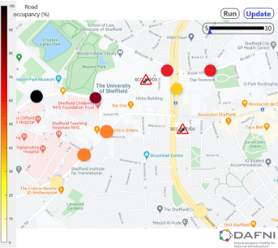
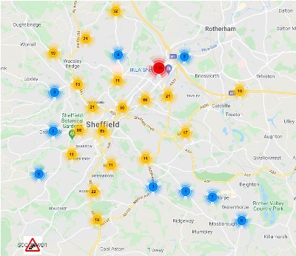
Pilot Study
Traffic Digital Twin in Sheffield
Christian Genes, Daniel Coca
Traffic data from the Sheffield Urban Observatory
640 sensors that report traffic flow (number of cars per minute)
Time resolution: 5 minutes
Build AI-based model
Updates in real-time for each sensor
Predicts evolution of traffic (ex: 30 minutes ahead)
Digital replica of Sheffield traffic
Identify areas where congestion will occur
Use cases:
Traffic monitoring system to predict congested areas
Real-time traffic flow optimisation

Slide 16

OpenCLIM
Topic Areas
Biodiversity/land cover
Urban development
Agriculture
Heat stress
Inland flooding
Drought and water supply
Models
HEAT: sWGBT, VP​
ARCADIA: mortality risk, residential discomfort, labor productivity​
HBV & SHERTRAN: streamflow, runoff depth, reservoir flow, soil moisture, g’water​
CityCAT: fine scale surface water floods​
Future Flood Explorer: flood risk and damages ​
National Water Simulation: reservoir storage, water restrictions, abstraction shortfalls​
CropNET & EcoCROP: potential/actual crop yield, crop suitability ​
Urban Development Model (UDM): spatial development, land use​
Wallace Initiative: species richness, climate change refugia for biodiversity
Fluvial Flooding
A) Climate-related flood hazard​
How might climate change impact flood risk and damages in the future across the UK and the devolved administrations?​
What is the most important ‘gap’ you see in existing climate flood risk assessments?​
What areas of uncertainty that may influence future flood risk concern you most?​
B) Adaptation to flood risk​
How might changes in development affect flood risk?​
How can we reduce flood risk through carefully designed land use change?​
What is the most important sectoral influence on flooding for OpenClim to consider?

Slide 17
CReDO
CReDo Climate Resilience Demonstrator
Investigate impact of flooding
Impact on communications infrastructure, water/sewerage, power
Infrastructure failures cascade – e.g loss of power impacts comms networks
Asset owners: BT, Anglian Water, UK Power Networks
DAFNI’s role is:
Provide the secure data platform trusted by all participants to support Digital Twins
Enable collaboration while enforcing the security requirements imposed by asset owners
Run the flood simulations on DAFNI
Help modellers containerise their models
Collaboration with: BT, Anglian Water, UK Power Networks, STFC’s Hartree Centre
A place to make data and models available for long-term accessibility

Slide 18
BSRW Projects
Developing a Resilience Framework
USARIS Dr Francesca Pianosi, University of Bristol | Uncertainty quantification and sensitivity analysis for resilient infrastructure systems
Exploring Resilience Scenarios
STORMS Dr Xilin Xia, University of Birmingham | Strategies and Tools for Resilience of Buried Infrastructure to Meteorological Shocks
RIWS Dr Ana Mijic, Imperial College London | Resilience Scenarios for Integrated Water
SOFRAMODE Dr Vassilis Glenis, University of Newcastle | Sewer overflow flood risk analysis model DAFNI enabled
NIRD Dr Raghav Pant, University of Oxford | Systemic resilience of interdependent infrastructure networks at the national scale
Supporting Key Models
Pywr-WREW Dr Anna Murgatroyd, University of Oxford | A Water Resources model for England and Wales built in Python water resources simulation system
FIRM Prof. Richard Dawson, University of Newcastle | An agent-based model of flood infrastructure resilience – FIRM
SCQUAIR Dr Richard Milton, University College London | Small Changes and Computer-Generated Spatial Interaction Modelling with QUANT

Slide 19
BSRW “Sandpit” Projects
Transport
ClimaTracks Solutions (Rail) Giuliano Punzo, University of Sheffield; Ji-Eun Byun, University of Glasgow; Qian Fu, University of Birmingham; Tohid Erfani, UCL; Iryna Yevseyeva, De Montfort University; Kostas Nikolopoulos, Durham University | Forecasting resilience of railway network under propagating uncertainty
IMPACT (Road) Dr. Qiuchen Lu, UCL; Prof. Tao Cheng, Mr. Xuhui Lin, Dr Tohid Erfani, Dr Trung Hieu Tran | Improving flood disrupted road networks resilience with dynamic people-centric digital twins
MARS (Airports) Fabian Steinmann, Cranfield University | Flight Diversion Modelling for the UK Aviation System
Energy
D-RES Desen Kirli, University of Edinburgh; Laiz Souto, University of Bristol | Provision of distributed grid resilience using EVs during extreme weather events
ForNET Kostas Nikolopoulos, Durham University; Lu Yang, York St John University; Haoran Zhang, University College London | DAFNI Forecasting Services for Energy Networks resilience using EVs during extreme weather events
BRINES Hannah Bloomfield, Newcastle University; Sean Wilkinson, Newcastle University; Ji-Eun Byun, University of Glasgow | Building risk-informed redundancy in energy systems transitioning to net-zero

Slide 20
Summary
DAFNI enables different parties to collaborate around models and data and to create workflows
Providing a point at which other parties can discover and (with owner permission) reuse the resources
DAFNI is home to 100s of models and data sets
Created by academia
Used by policy makers and industry for applied research
DAFNI is free to use
Providing an exploitation route to projects
Extending the life of research beyond initial funding

