Slide 1




Coast-R Small Grants Fund Round 1
Information Webinar & Q&A :
7th October 2025
ukcoastalresilience.org
#CoastRNetwork

Slide 2
2. Coast-R N+ & ReCCs overview
ukcoastalresilience.org
#CoastRNetwork

Slide 3
The ReCCS Programme
The Resilient UK Coastal Communities and Seas programme (2024-28) is a £14.8M investment consisting of a Network Plus, Flexible Fund and 4 research grants (projects).
Programme aims:
Build a transdisciplinary, whole systems understanding of UK coastal seas, coastal communities and coastal natural capital.
Support collaboration with stakeholders to build understanding and enable transformative decision-making.
Enhance community knowledge mobilisation and improve resilience in the management of UK coastal areas and seas.

Slide 4
4 ReCCS projects
Advancing Resilience and Innovation for a Sustainable Environment (ARISE)
Gina Reinhardt, University of Essex
Resilience of the Anthropocene coasts and communities: assessing and responding to urban and post-industrial coastal risks (RACC)
Kate Spencer, Queen Mary University of London
Transformative Research Actions for Resilient Coastal Communities (TRACC)
Tim Acott (Co-Lead), University of Greenwich
Jasper Kenter (Co-Lead), Aberystwyth University
Transitions in Energy for Coastal communities over Time and Space (TRANSECTS)
Karen Alexander, Heriot-Watt University

Slide 5
COastal Communities & Seas Together for Resilience (aka Coast-R Network)
Coast-R is an inclusive and action-driven community of practice working to build knowledge, action and resilience for UK coastal communities and seas.
It champions research & knowledge exchange across the ReCCS programme, directs the Flexible Fund, and seeks to scale and embed place-based interventions into policy & practice, thereby delivering a step-change in UK coastal resilience.
Join up via ukcoastalresilience.org or email:
COASTR@hull.ac.uk

Slide 6

Our objectives
Sharing learnings and good practice across sectors and disciplines so as to build UK coastal and marine resilience.
Co-designing and hosting events, training and mentoring to improve partnership working and nurture the next generation of resilience champions.
Working in partnership with coastal communities and partners to identify and respond to priority needs using our Flexible Fund.
Collating key insights, case studies and resources through our website, policy briefs, foresight documents, conferences and practitioner events.
Building ongoing practitioner and community-led evaluation and reflection on the activities of the Network+ and funded projects, and thereby shape future learning, legacy and funding opportunities.

Slide 7

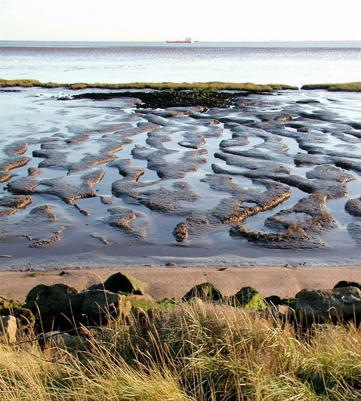
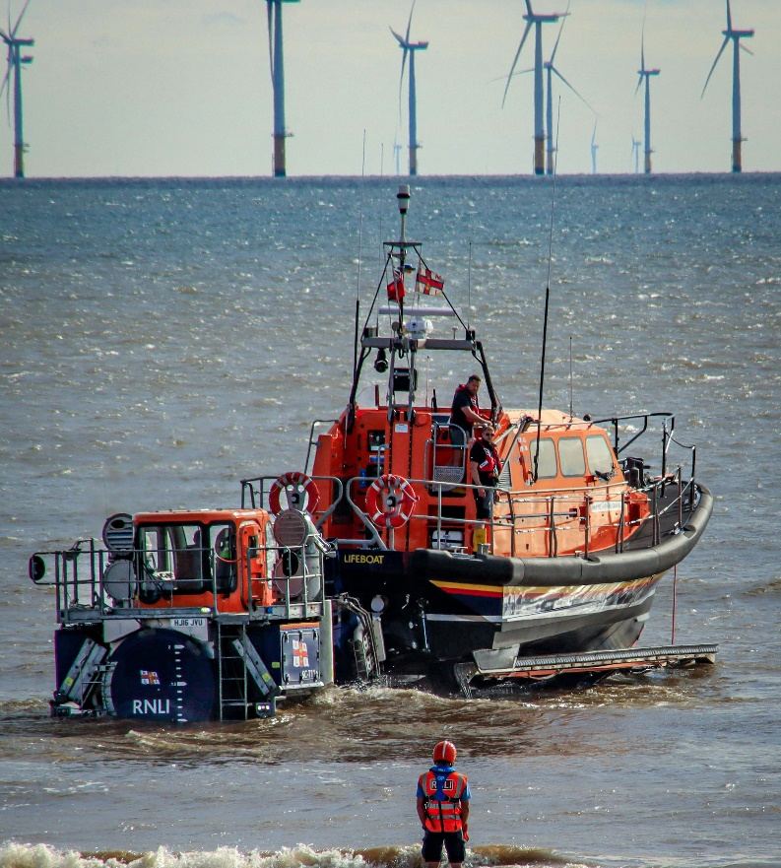
Our cross-cutting themes
People, places and participation
Living with coastal (un)certainties
Working together at interfaces
Notes:
People, places and participation – Working together to develop best practice and training. Focusing on the use of creative and participatory methods to involve communities and stakeholders in building coastal resilience.
Living with coastal (un)certainties –Exploring levels of uncertainty in coastal data and modelling, including those involving complex risks. Considering how communities live with shifting predictions and changing environments.
Working together at interfaces – Developing skills for working across different disciplines. Sharing strategies, toolkits, and guidance to support implementing effective resilience actions.

Slide 8
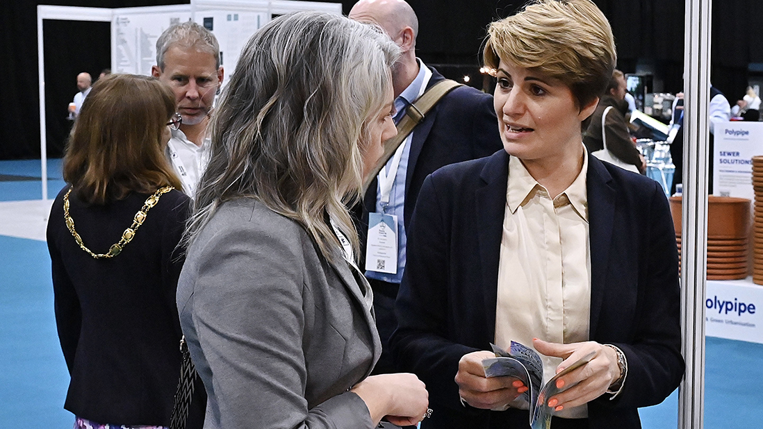

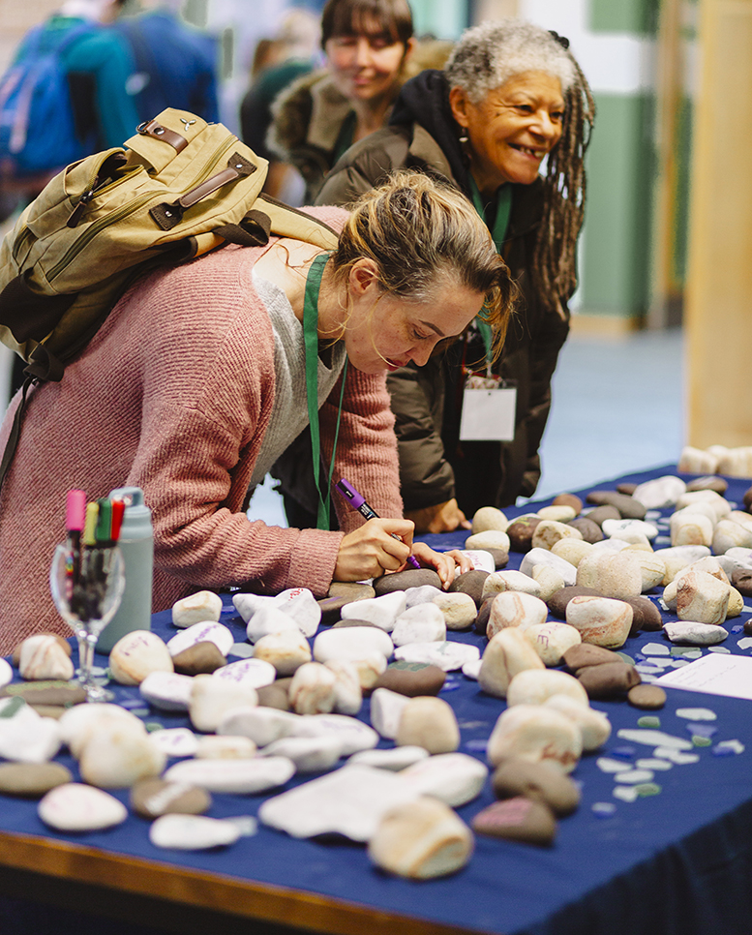

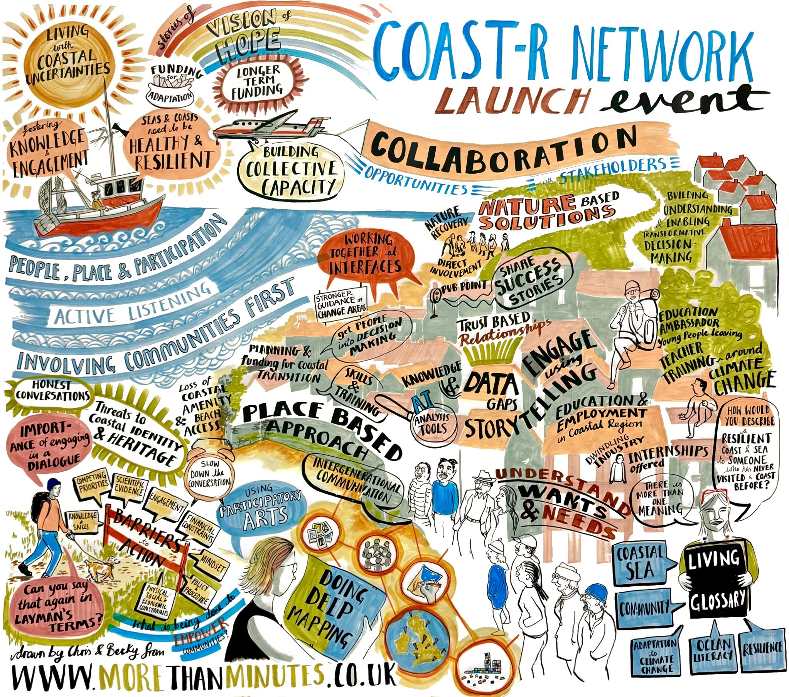
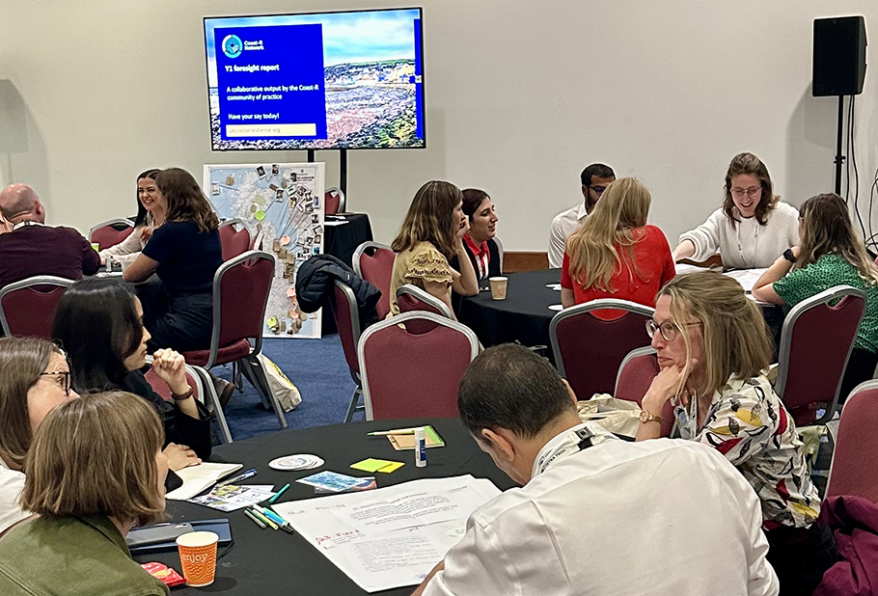
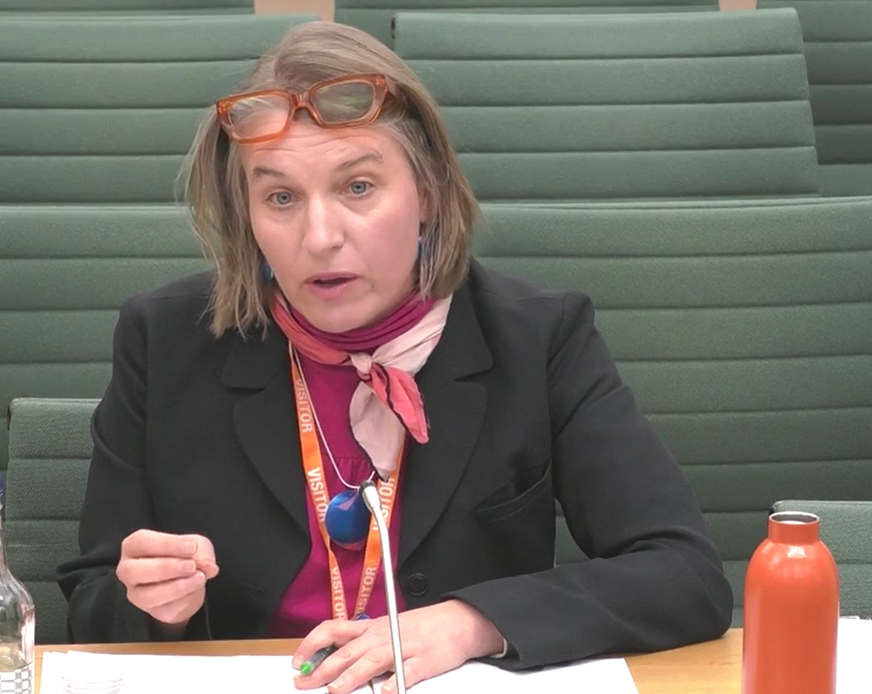
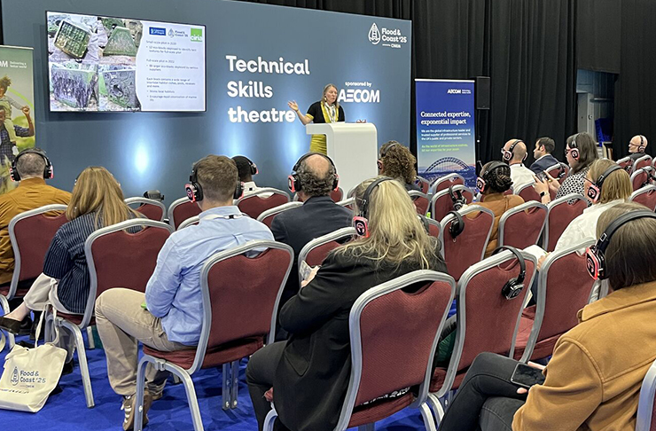
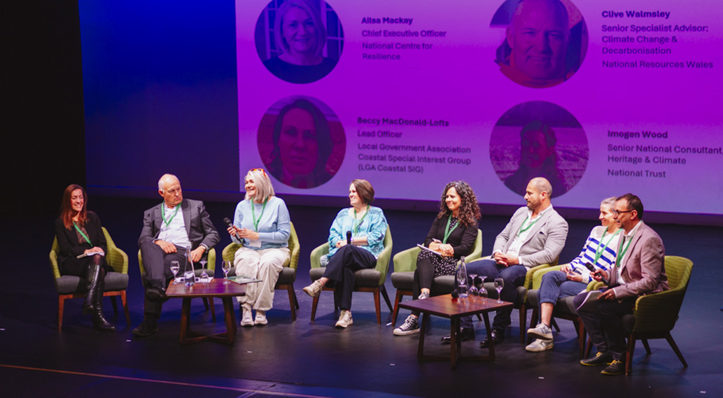
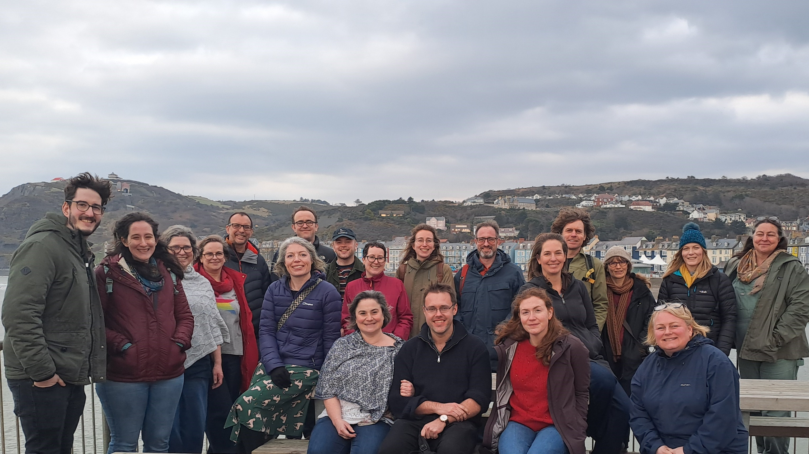

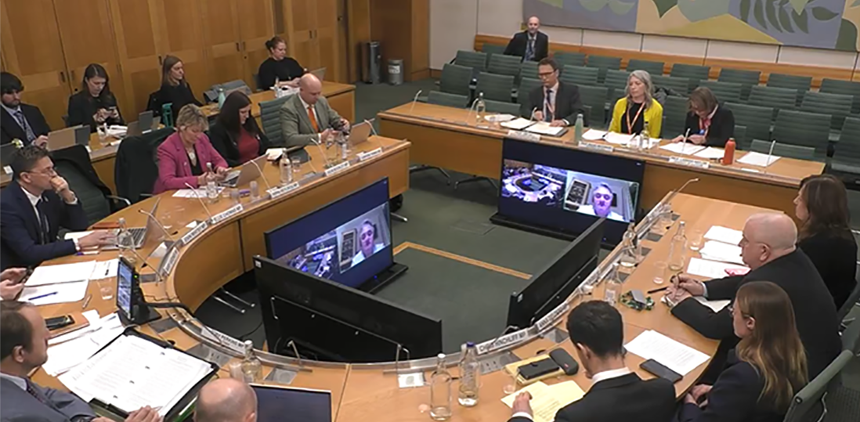
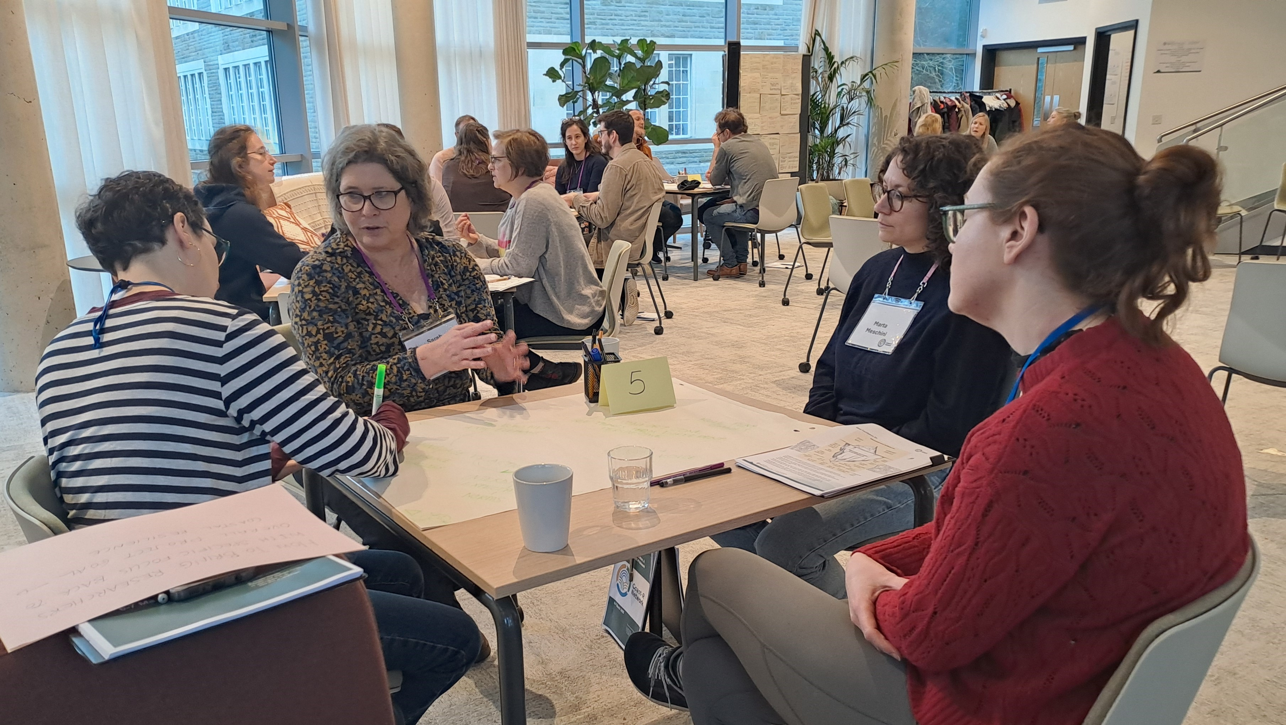
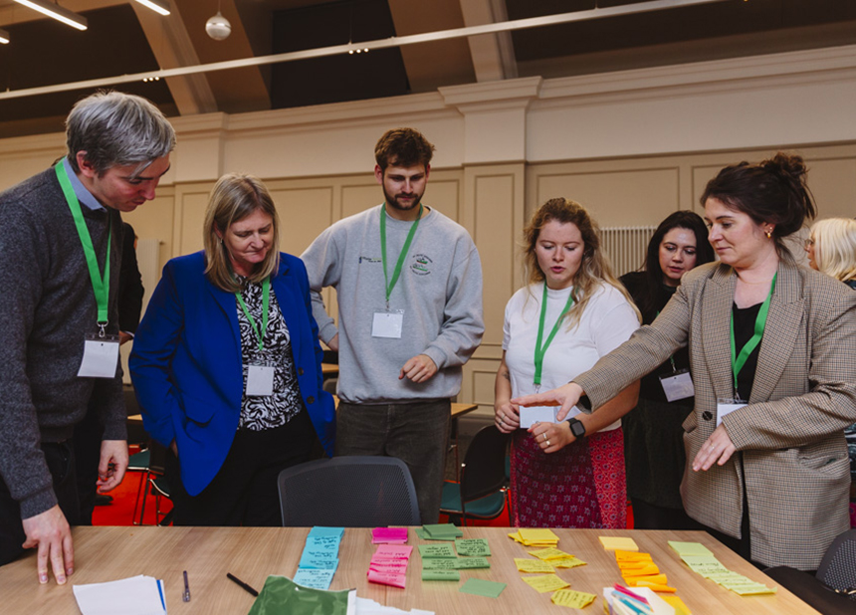
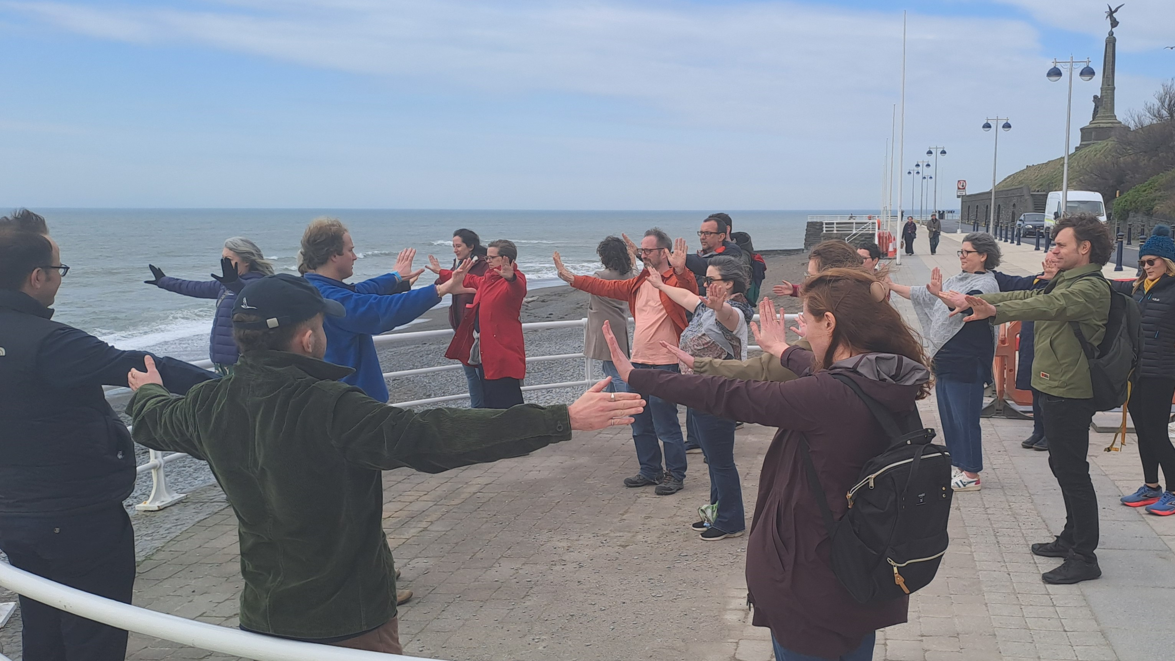

Slide 9
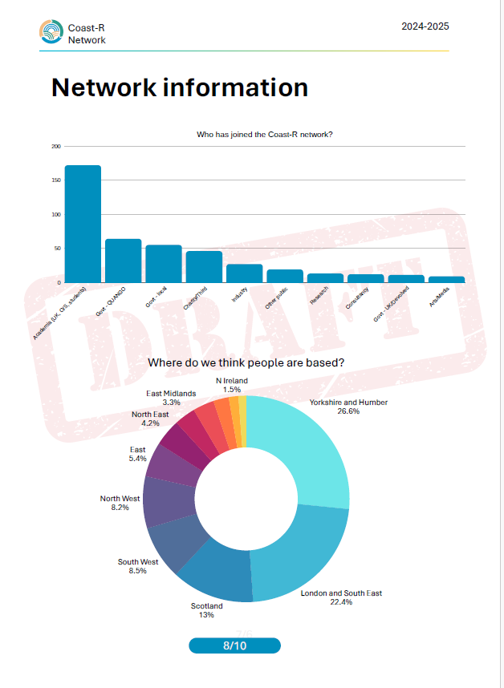
COastal Communities And Seas Together for Resilience (COAST-R Network+)
KEY NUMBERS SO FAR
440 network sign-ups
885 LinkedIn followers
23 engagement activities, reaching 2878 people
2 gov.uk committee appearances
1 gov.uk inquiry submission
3 webinars held
ukcoastalresilience.org
#CoastRNetwork
Notes:
The Coast-R Network is a diverse and growing team, including academics, UK marine, coastal and government agencies, industry partners, local authorities, the voluntary sector and communities most affected by coastal change.
Together, we are working to better understand coastal change and enhance the resilient management of UK coastal communities and seas, and the natural capital that sustains them.
Coast-R will:
Share learnings and best practice across sectors and disciplines so as to build UK coastal and marine resilience.
Co-design and host a range of events, specialist training workshops and mentoring opportunities to improve partnership working and nurture the next generation of resilience champions.
Work in partnership with coastal communities and other partners to identify and respond to priority needs using our Flexible Fund.
Collate key insights, case studies and resources through our website, policy briefs, foresight documents, conferences and practitioner events.
Build ongoing practitioner and community-led evaluation and reflection on the activities of the Network+ and funded projects, and thereby shape future learning, legacy and funding opportunities.

Slide 10
2. Small Grants Fund (Round 1)
www.ukcoastalresilience.org/small-grants-fund-round-1
#CoastRNetwork

Slide 11
Overarching Focus : Round 1
Round 1 of our SGF will support small scale, place-based projects involving early career researchers (post-doctoral) in two-way / multi-way research and knowledge exchange.
We particularly encourage projects which :
Involve partnership and cross-sectoral working;
Include the active engagement of individuals and organisations with lived experience of coastal change; and
Will scale and embed research, knowledge and learning about coastal and marine resilience across & between sectors and communities.

Slide 12
This might include activities which :
Generate new learning, data, approaches or resources;
Make existing research findings accessible to new and more diverse audiences; and/or
Inform policy and enable transformative decision making at community level.

Slide 13
Round 1 Priority Activity Areas : (x 6) :
Translating knowledge/making research findings accessible to new audiences including practitioners, policymakers and/or researchers.
Collating or scaling up learning across regions, devolved nations, or sectors.
Developing new toolkits & approaches, including for delivering community engagement ‘at scale’.
Fostering the exchange of ideas and approaches between coastal communities ‘at risk’.
Developing improved evaluation and monitoring of existing projects.
Fostering skills for inclusive resilience, including amplifying ‘least heard’ voices.

Slide 14
Funding Pathways & Grant Size :
Funding Pathways available (x2) :
Starter Funds : Grant Value : Minimum £5000, maximum £7500*
Designed to be inclusive of smaller grassroots level activities.
Develop ideas, build experience, and enhance production & exchange of learning.
Larger Funds : Grant Value : Minimum £7501, maximum £25,000*
Designed to develop more established ideas & approaches in greater depth.
Delivery period likely/expected to be longer in duration.
*Inclusive of non-recoverable VAT.

Slide 15
Eligibility (1) :
Applications must demonstrate the following :
Involve the active and meaningful engagement* of a post-doctoral Early Career Researcher (*ideally, as Project Lead or Co-lead).
ECR must be employed at a UK University or other eligible UKRI-funded organisation. (Can advise if needed).
Not open to PGRs.

Slide 16
Eligibility (2) :
ECR definition : Post-doctoral, exploring research leadership potential.
Self-defining : Typically within 8 years post-doctorate, but not always, & taking account of career breaks.
Must start delivery from 1st Feb 26, and complete delivery by 31st Oct 26 (ie. 9 months).

Slide 17
Grant Awards & FEC :
In line with UKRI requirements for grants to ‘eligible organisations’, grants will be awarded at 80% of FEC.
Examples :
Minimum £5000 grant award (awarded at 80% FEC) would require a minimum total project budget value of £6250 (at 100% FEC).
Maximum £25,000 grant award (awarded at 80% of FEC) would require a total project budget value of £31,250 (at 100% FEC).

Slide 18
Examples of Eligible Costs:
Workshops, activities and event costs | Travel and subsistence costs for workshops and events | Costs of organising activities
Materials & small scale equipment directly connected to delivery. | Community participation expenses | Staff costs required for specific elements of running the project
Training costs | Directly Allocated staffing costs associated with employment of the ECR (no limit) | Other DA staffing, DA overheads, Estates& Indirects : Limited to 20% of total grant requested.

Slide 19
Exclusions :
The following costs are not eligible :
Costs incurred prior to the date of grant approval.
Pre-existing activity or ongoing operations.
Costs which are already subject to a grant / finance from another source.
PhD stipends or fees.
Religious & party-political activity.
Alcohol.

Slide 20
Limitations :
The following costs may not in combination exceed 20% of the total grant figure requested :
DA staffing costs which are not directly related to the employment (salary & employer oncosts) of the ECR in question.
DA overhead costs.
DA indirect costs.
Note :There is no limitation on DA employment costs directly related to the ECR themselves, (ie. where the ECR is classed as a DA staffing cost).

Slide 21
Limitations : Examples :
Example 1 : Smaller Funds Application
Total budget (at 100% FEC) : £6250
Amount of grant awarded by the Small Grants Fund (at 80% FEC): £5000
Maximum grant awarded for Other DA & Indirects : £1000 (20% of £5000 grant award).
Example 2 : Larger Funds Application
Total budget (at 100% FEC) : £31,250
Amount of grant awarded by the Small Grants Fund (at 80% FEC): £25,000
Maximum grant awarded for Other DA and Indirects : £5000 (20% of £25,000 grant award).

Slide 22
Mandatory Deliverables:
All projects must :
Contribute to a Coast-R Network webinar (held monthly);
Contribute to a blog for the Coast-R newsletter and website;
Progress report(s) : Quarterly (for Larger Funds) and Final (Starter Funds).

Slide 23
Other Outputs - Examples
Toolkits and ‘How to’ guides
Case studies and web resources
Training resources which can be adopted and used by others
Policy outputs, including briefs and foresight documents
Academic publications
Practitioner-focused publications/reports.

Slide 24
Submission Process & Timeline :
Submit applications to CoastR@hull.ac.uk : By 4pm, Friday 31st October.
Reviewing process : 1st – 21st November.
Applications decisions panel meeting held : by Friday 19th December.
Decisions out to applicants : By Tuesday 23rd December.
Contracts drafted and sent out to grant recipients : by 23rd January 2026.
Projects start delivery : From 1st February 2026.
Projects complete delivery : By 31st October 2026.
Projects complete monitoring & evaluation reporting : By 30th November 2026.

Slide 25
Questions ?

